Slide 1
Tech Writing Presentation
Matthew Bergman
Notes:
Hello, and welcome to my technical writing presentation. I’m going to talk a lot about what technical writing is for, who it benefits, and some of my favorite documentation programs.

Slide 2
Technical Writing
Who is it for?
Engineers
Financial advisors
Truckers
Coders
Retail Employees
Salespeople
Writers and Authors
Essentially, everyone with a job or hobby
Notes:
I think the greatest question we can ask is who does technical documentation benefit? Well, it benefits practically everyone. All jobs and hobbies require some form of instructional and routine documentation. Depending on your audience, the skill levels and styles of such instructions can vary greatly. However, there are some universal aspects to instructions I feel everyone benefits from.

Slide 3
Everyone needs instructions
What makes good instructions?
Well organized
Indexed properly
Accessible
Easy to read
Usable by most users possible
Notes:
There are certain axiomatically good principles of writing instructions that I feel everyone should implement. Good and clean organization is a must, as well as proper indexes and references. General instructional how-tos should be accessible and easy for most people to grasp. However, there are some cases where high skill level instructions are necessary, even if they may be incomprehensible to a novice.

Slide 4
Tech Writing Programs
What makes a good technical writing program?
Accessible to its end users
Reliable support & help system
Team use
Converts documents well
Easy to assemble documents and content.

Slide 5
What was my favorite?
Notes:
With all that said, throughout this class we interacted and created content in several different programs. I loved using some of the programs, while others could use some interface touchups. What among those was my favorite program?

Slide 6

Oxygen XML Author
Notes:
Oxygen XML Author!

Slide 7
Oxygen XML Author
Robust, lots of features
Can handle long documents
Customizable interface
Can create templates and share
Allows for long documents, like books
Notes:
To me, Oxygen XML Author has all the tools I need to make practically any piece of instructional documentation I want. Its greatest assets are that it can handle long, novel sized documents with ease. Teams and companies can make use of the customizable interface and easy maps sharing.

Slide 8
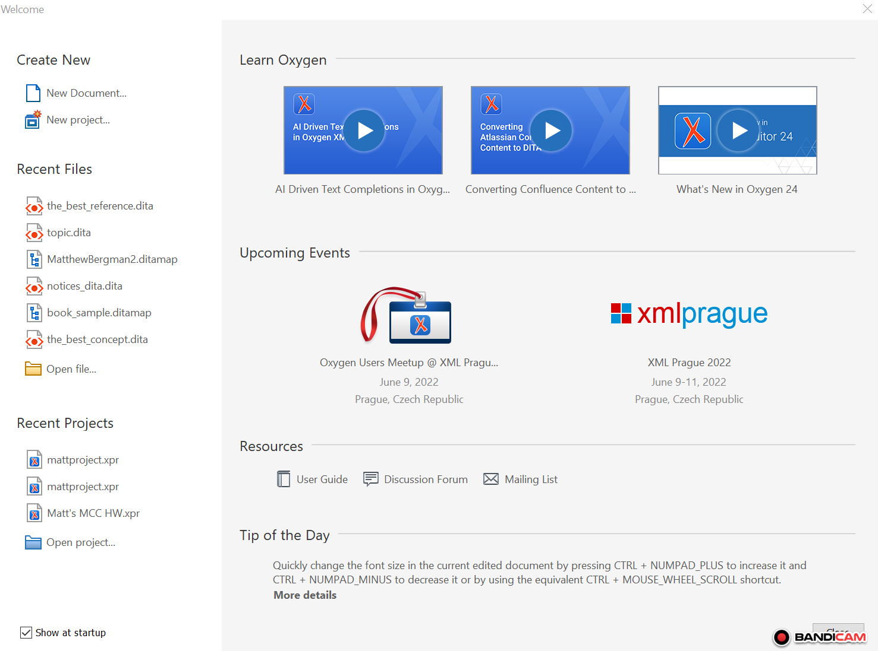
Notes:
When I start up the program, this is what I see. If you look up to Learn Oxygen, you can get some handy tutorials built straight into the program. I’ll however, simply open my project.

Slide 9
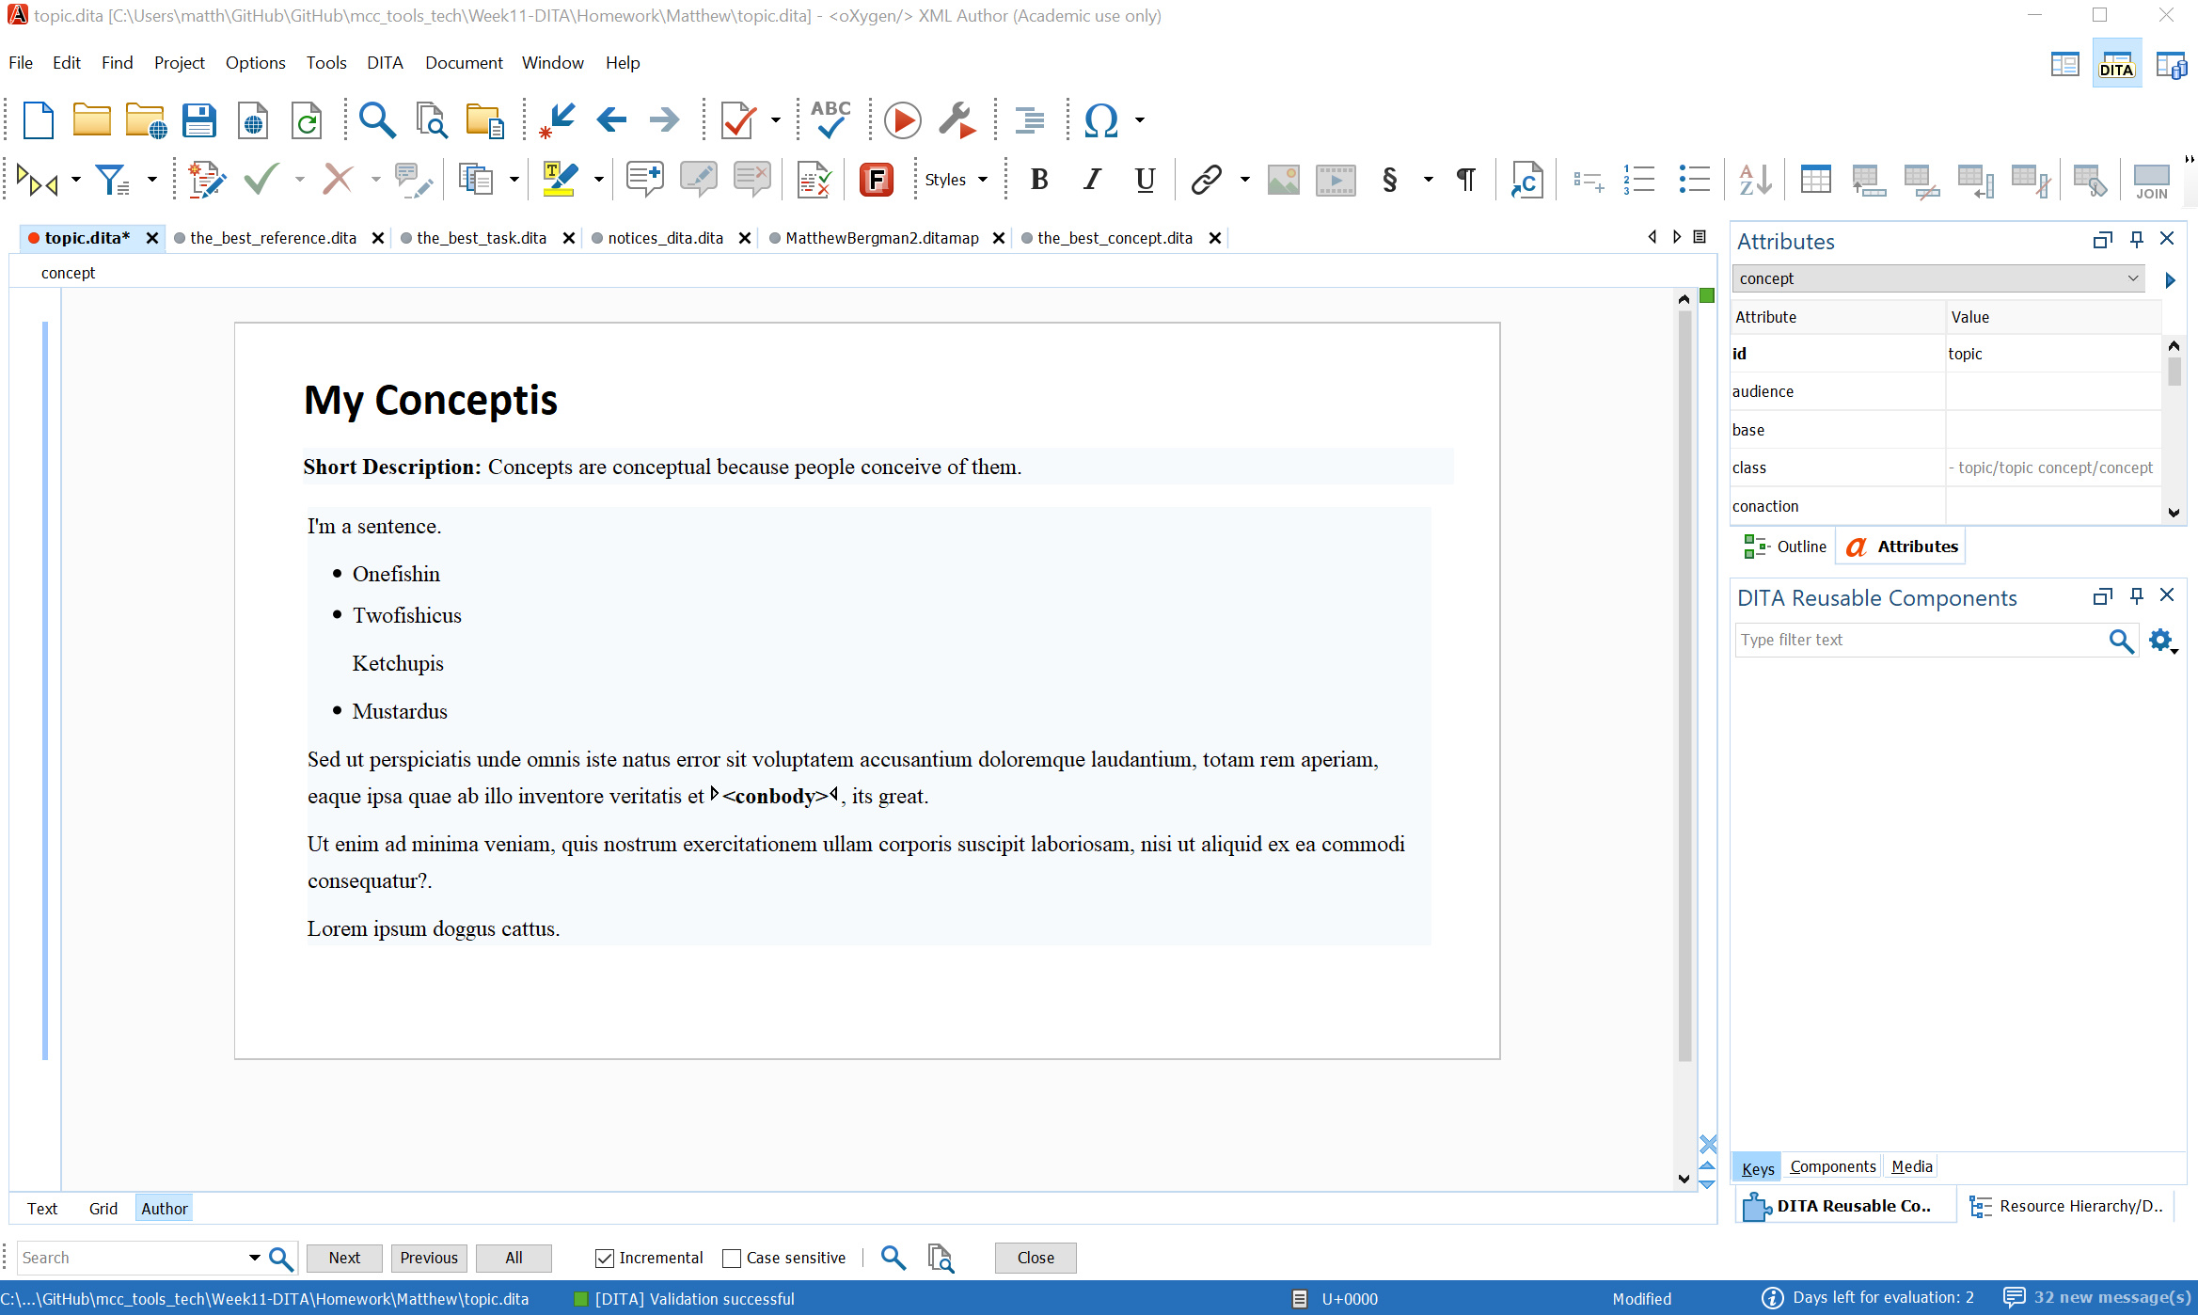
Notes:
Here is my big Concepts page, where I can type various bits of content and information.

Slide 10
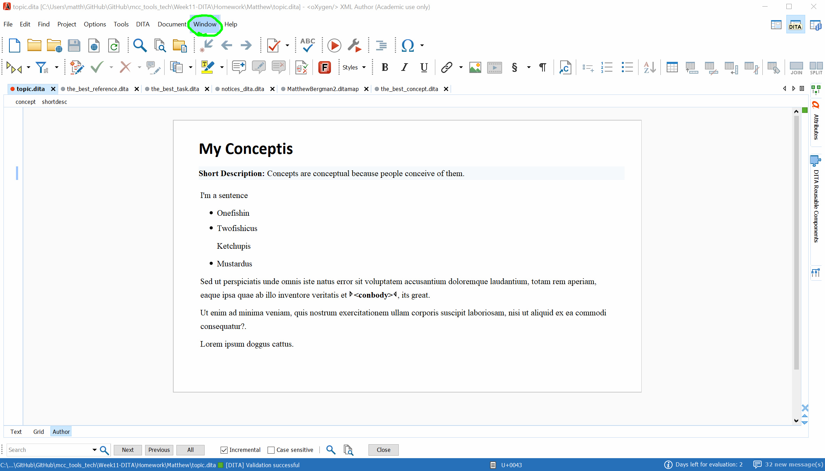
Notes:
I want to take a look at my complete map, so here’s what I do. I look up and click on Window.

Slide 11
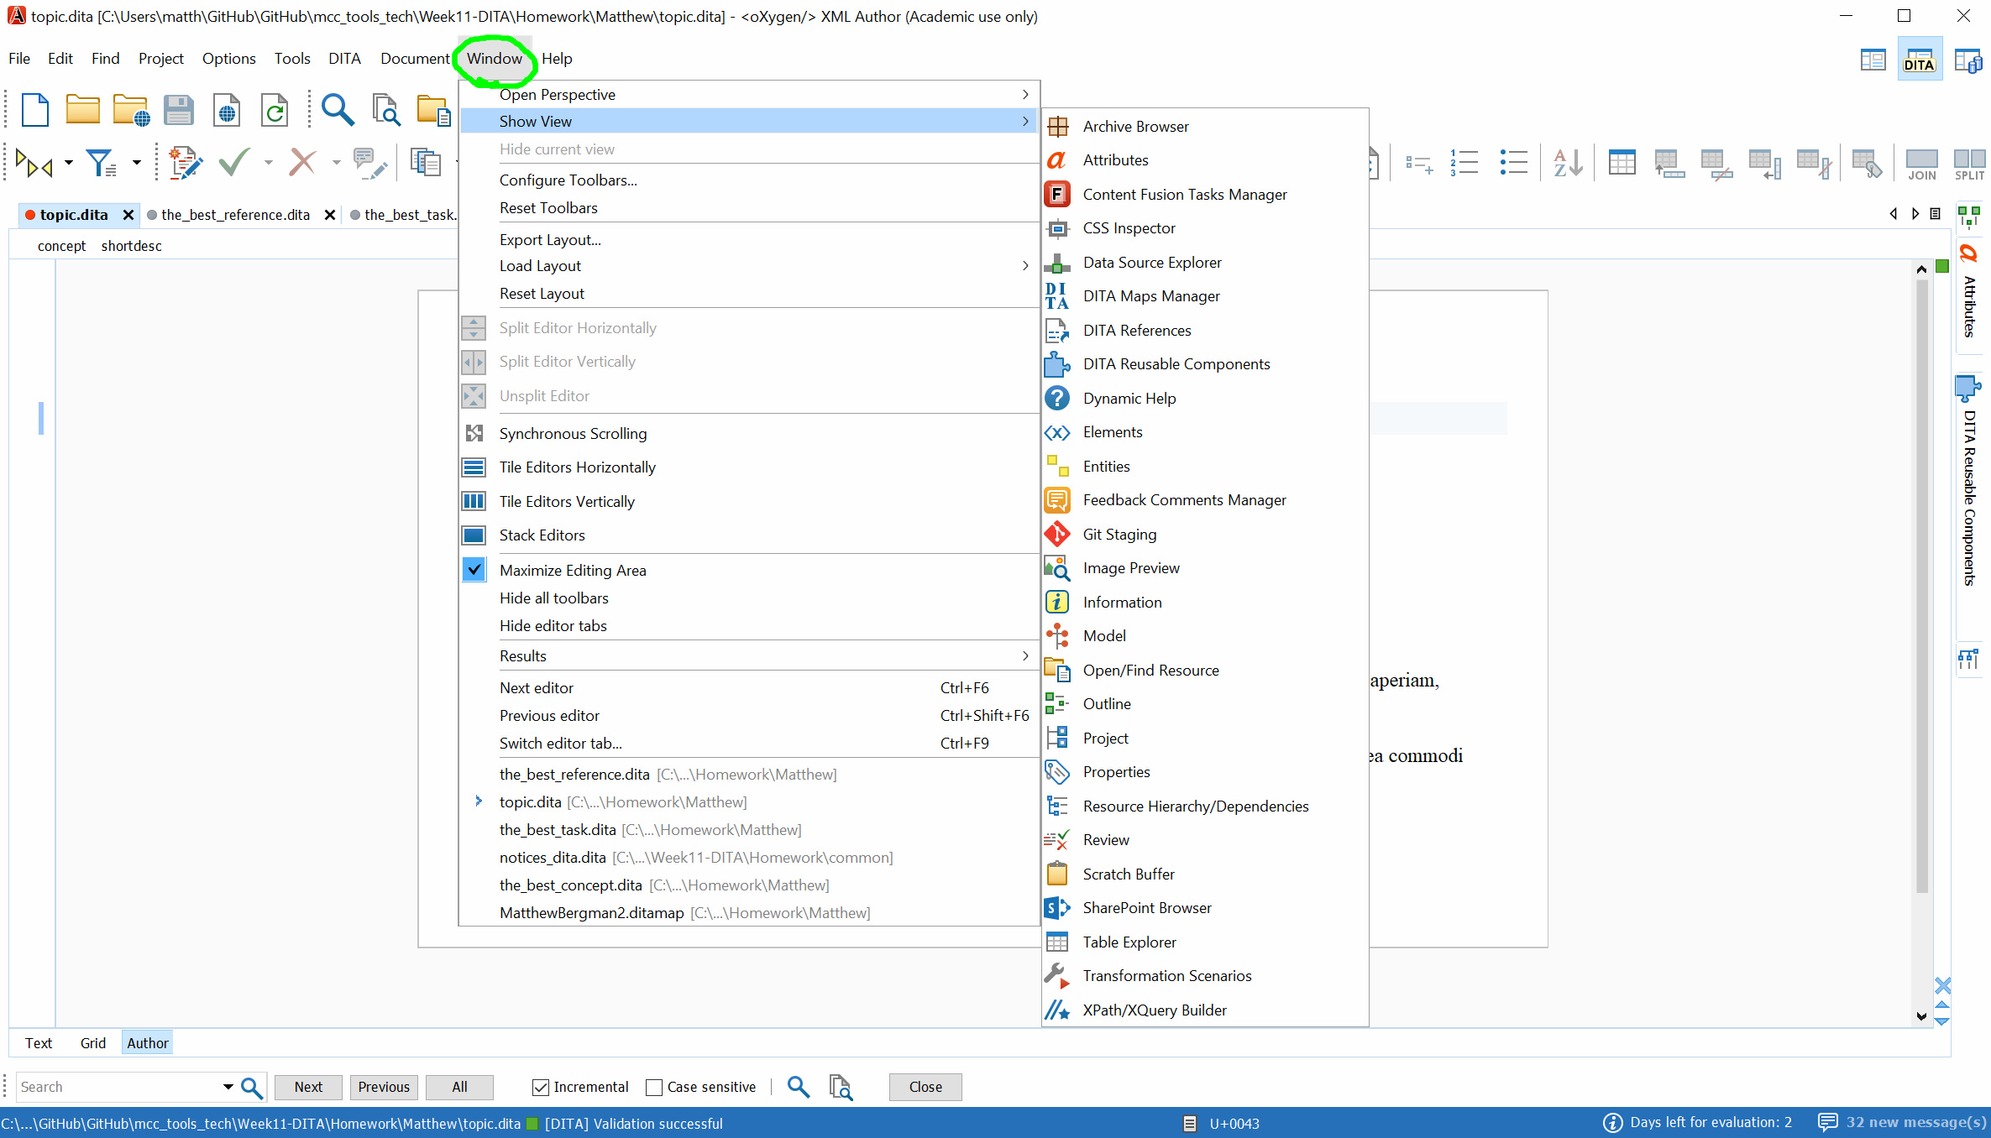
Notes:
Then I go to Show View

Slide 12
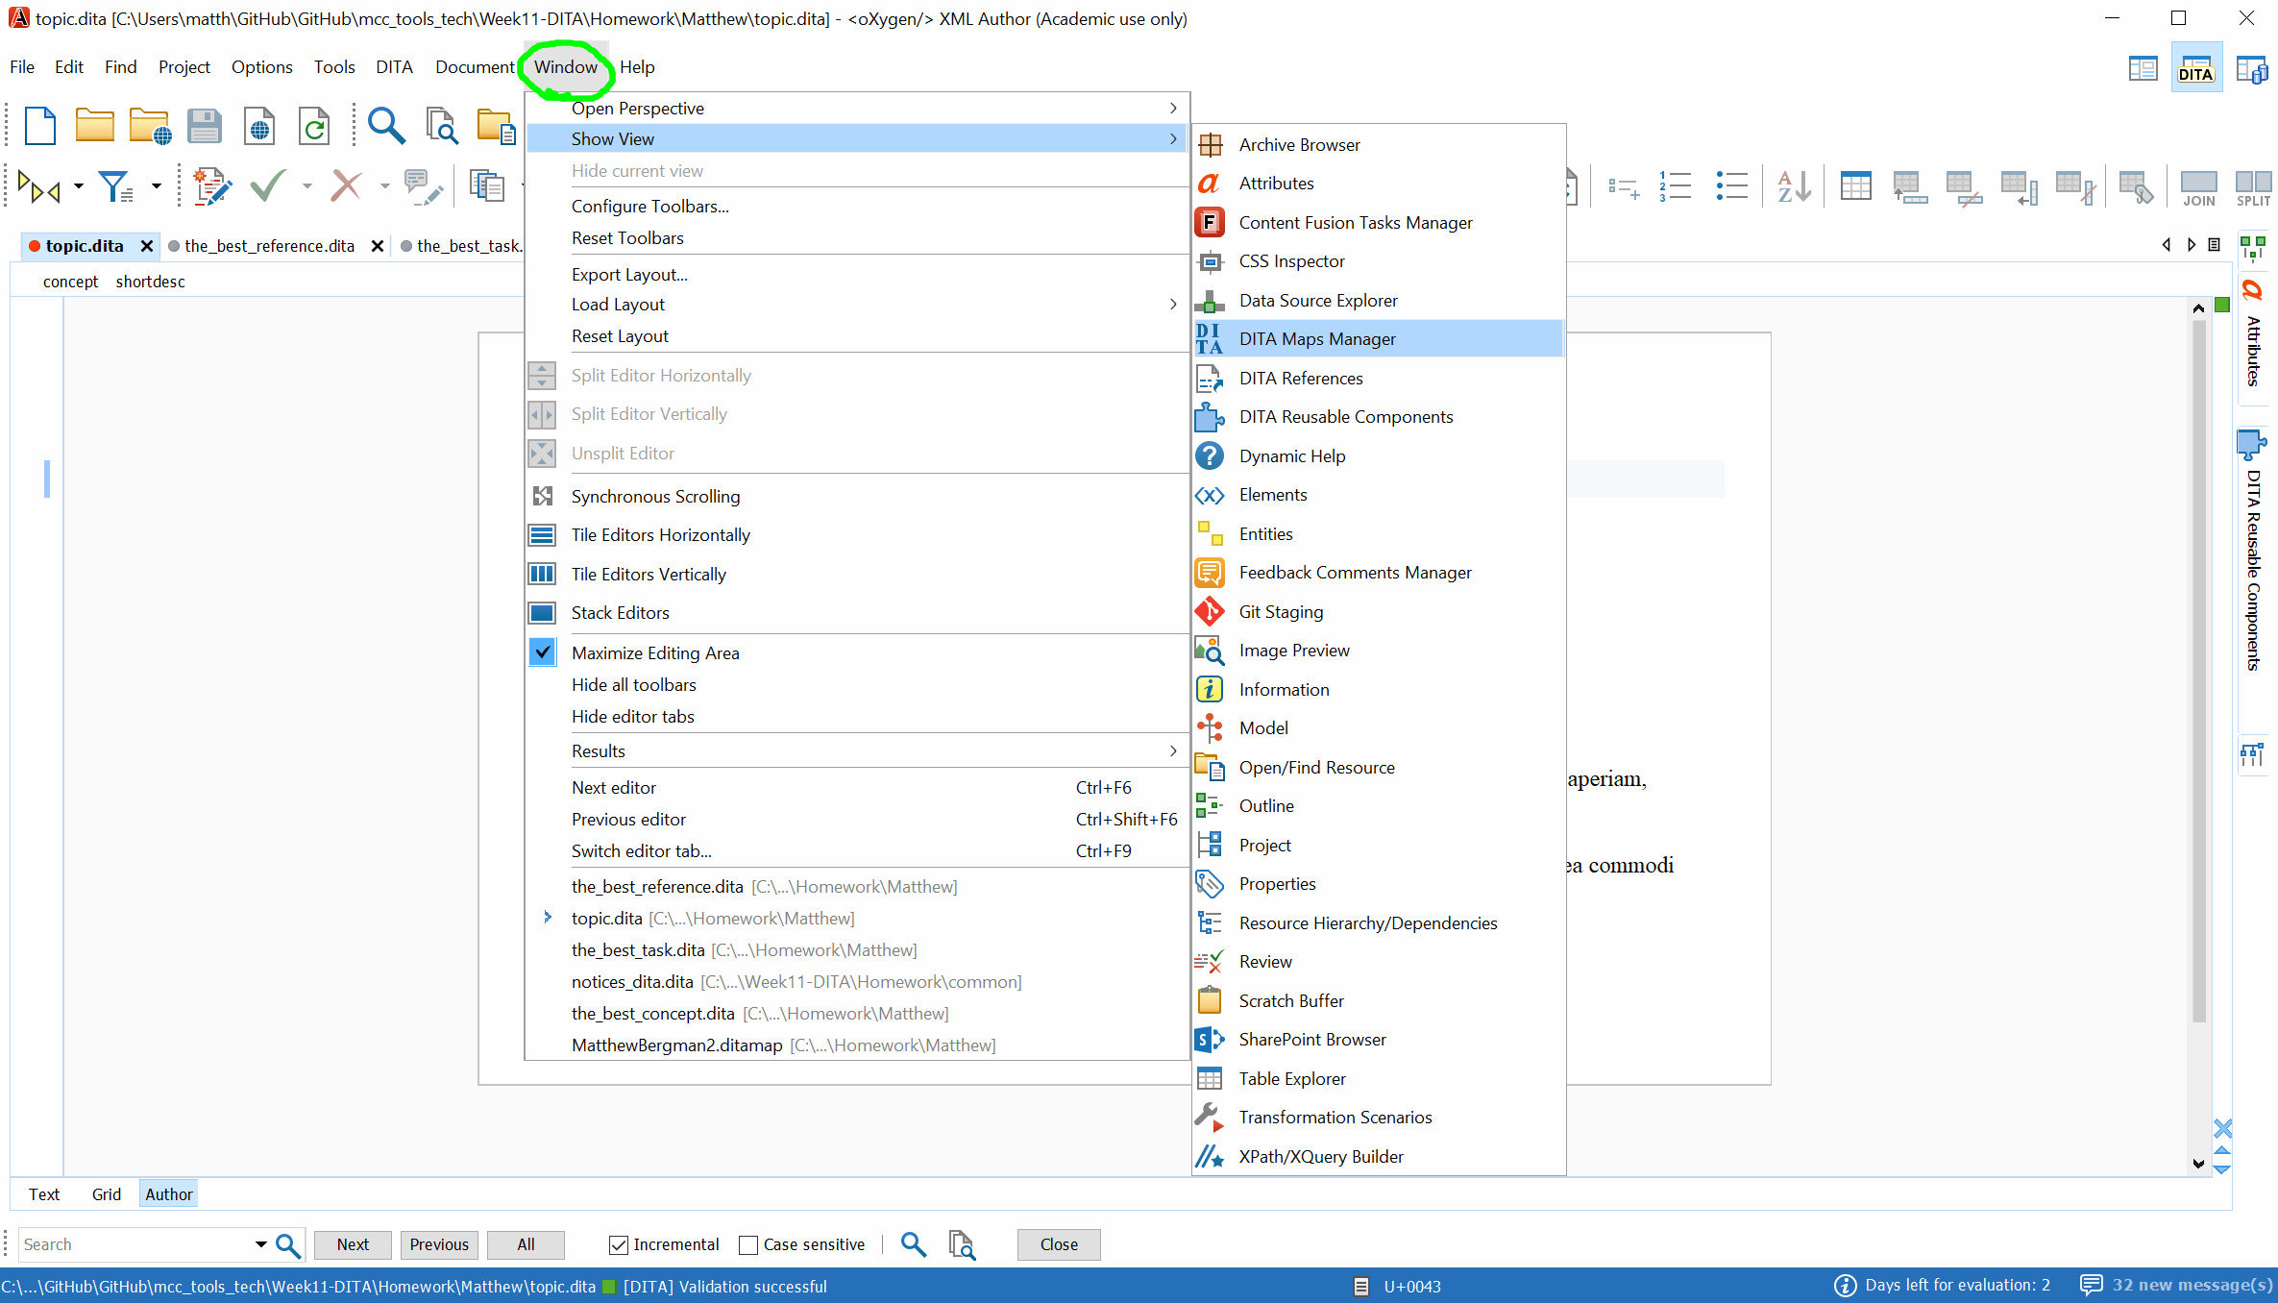
Notes:
From there I can select DITA Maps Manager

Slide 13
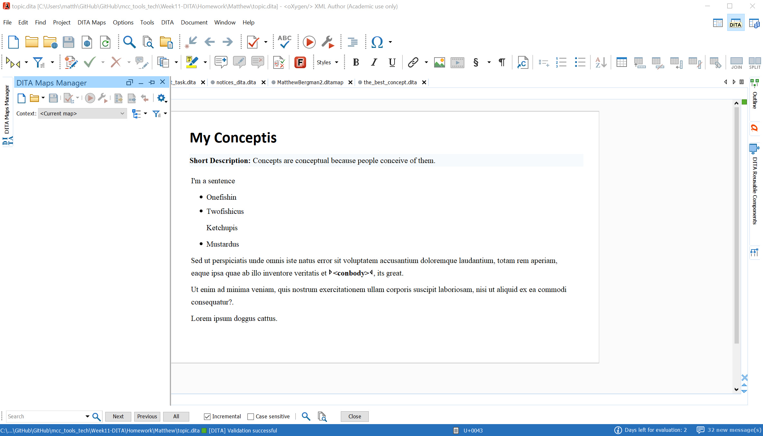
Notes:
If you look to your left you’ll see the empty maps page up. Lets fix that!

Slide 14
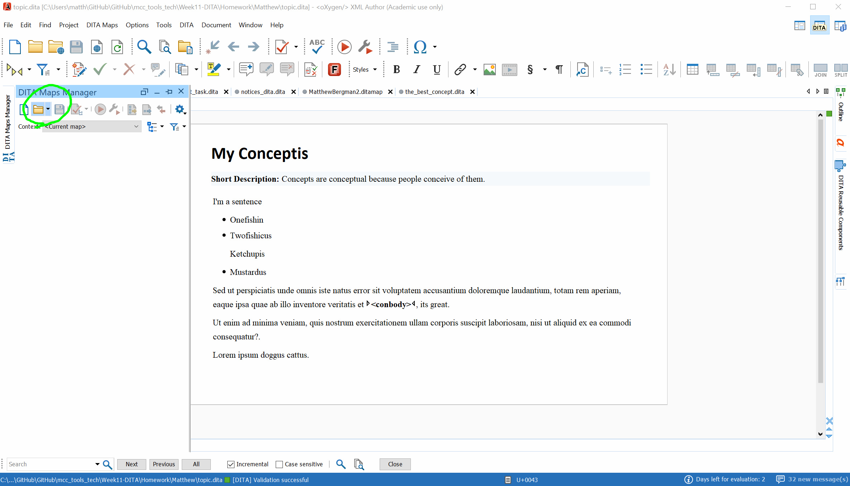
Notes:
Click on the folder within the manager.

Slide 15
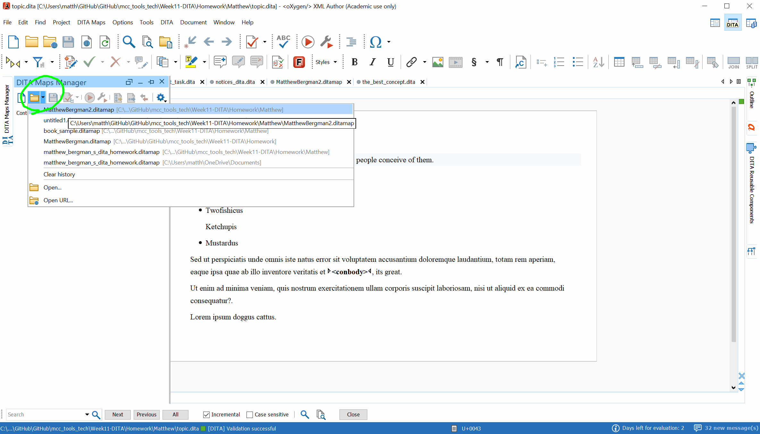
Notes:
And select your desired map.

Slide 16
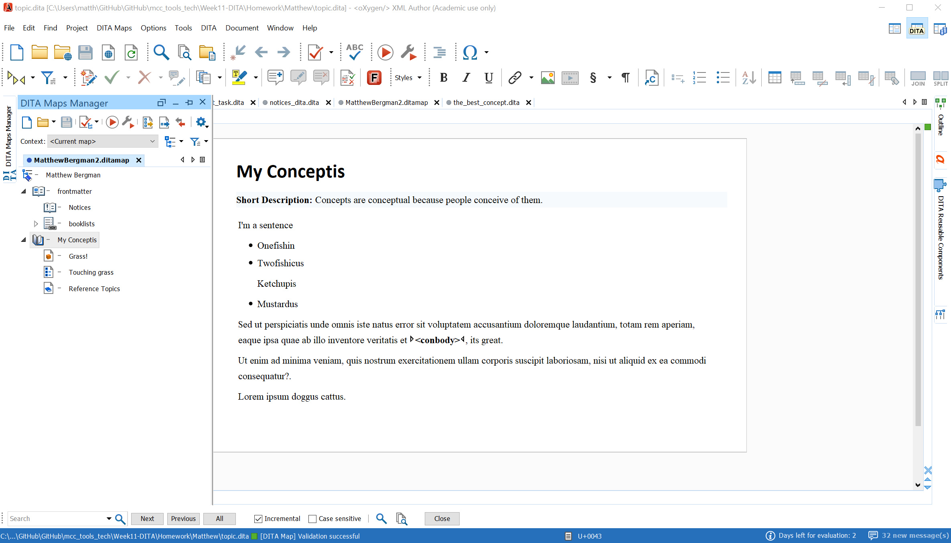
Notes:
There we go! A preset map that was shared among the class. Teams can use this sharing tool to streamline their work output, and make the program easier for more employees to use.

Slide 17
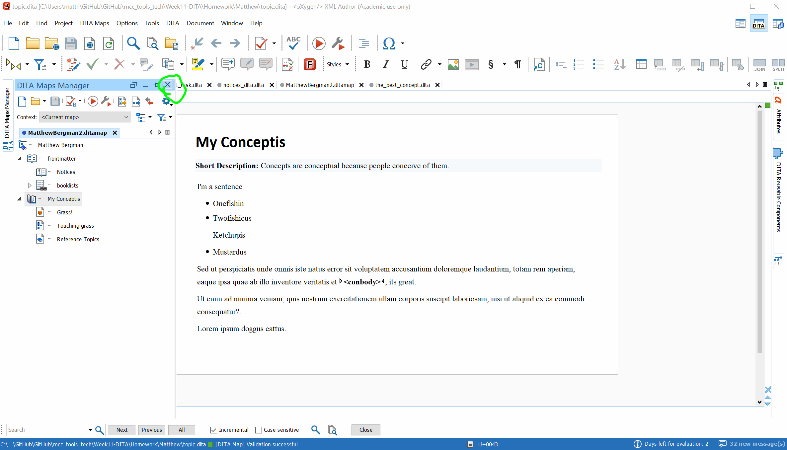
Notes:
Lets click out of DITA Maps Manager for now.

Slide 18
Notes:
And go back to our more basic view.

Slide 19
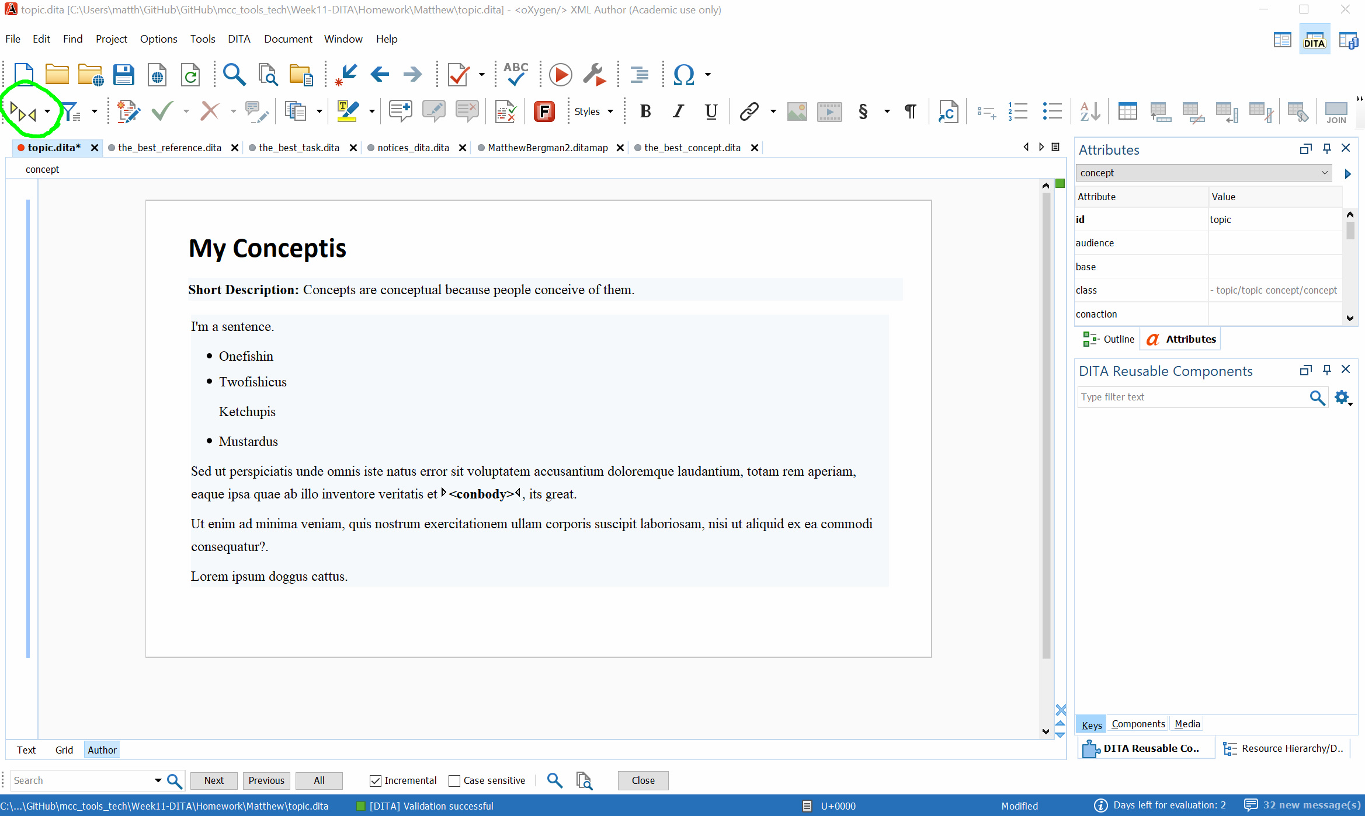
Notes:
I may hear some of you asking “Where are the tags?” That’s what I’m going to fix. Here lets click on this icon in the top left corner.

Slide 20
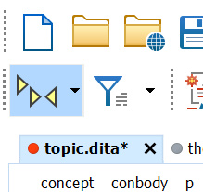
Notes:
Once selected, you can click on the icon to open up a new set of options.

Slide 21
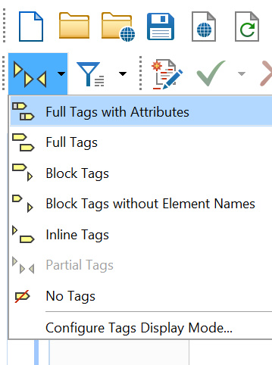
Notes:
I’ve selected the Full Tags with Attributes option, as this gives me a full, detailed view of all the content I have.

Slide 22
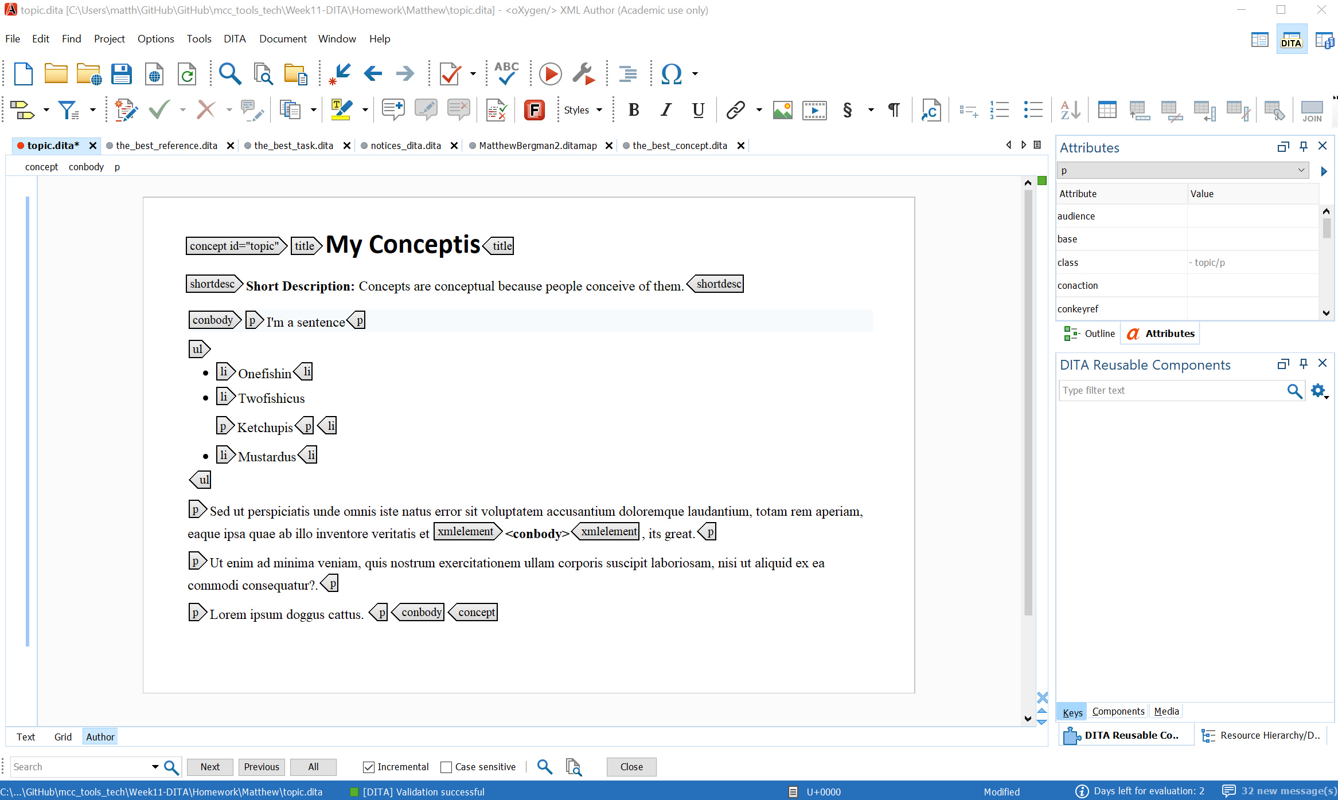
Notes:
Now we see what everything is, from the title to paragraphs, to even the list items and its list.

Slide 23
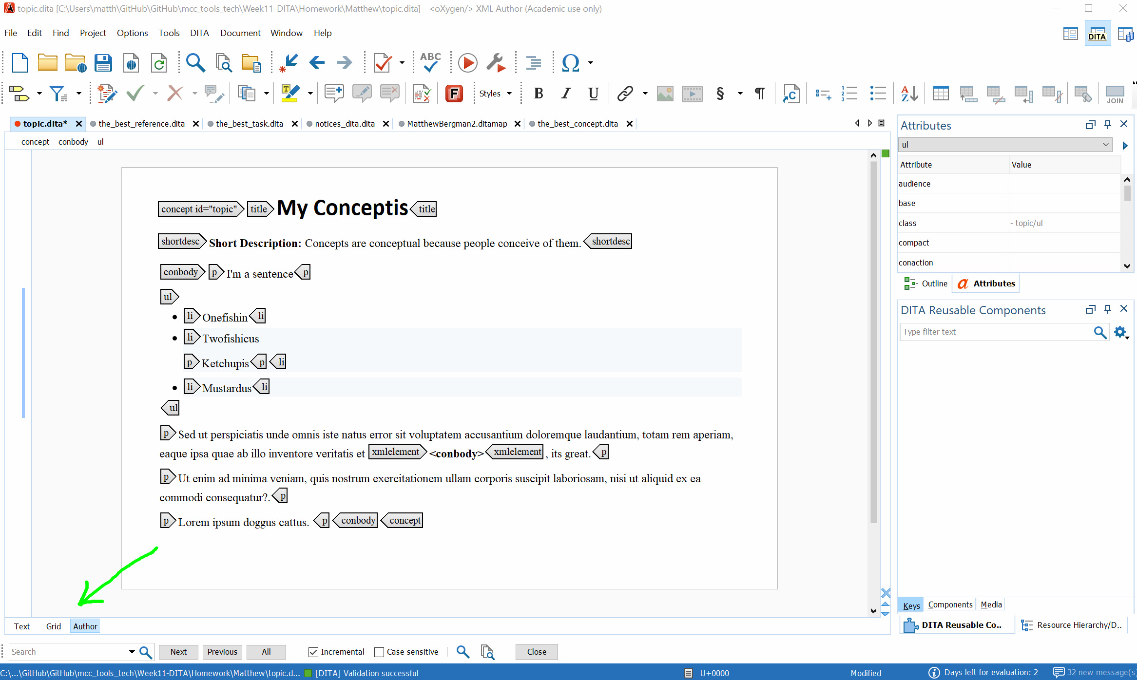
Notes:
How do we view this in a way that more resembles code?

Slide 24
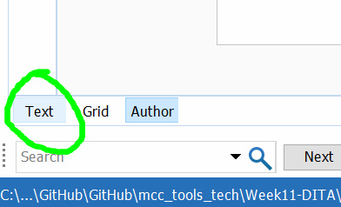
Notes:
Click on Text at the bottom left corner.

Slide 25
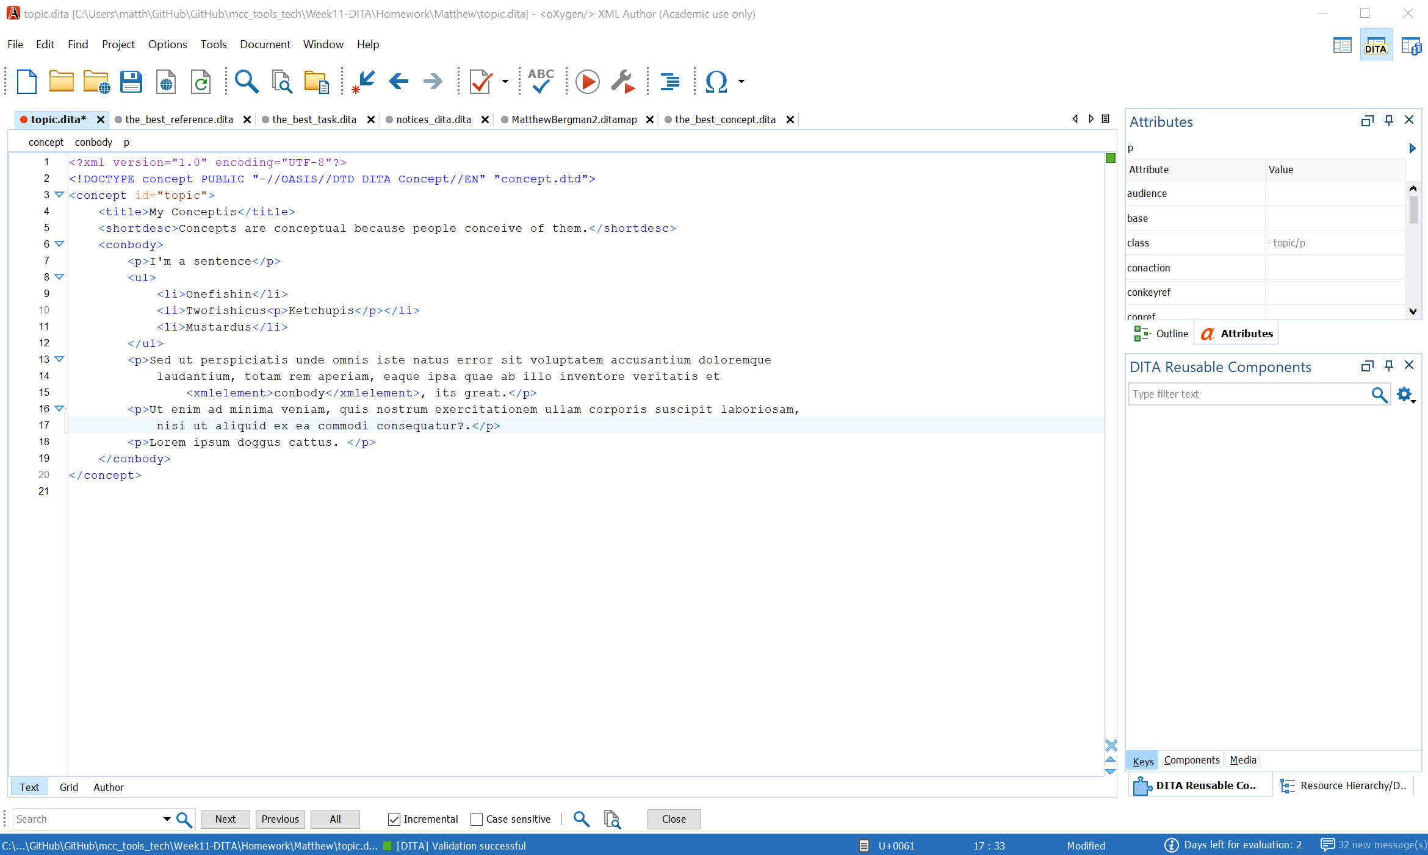
Notes:
Now your whole page has been converted to XML, where employees may be more easily able to edit and share its content.

Slide 26
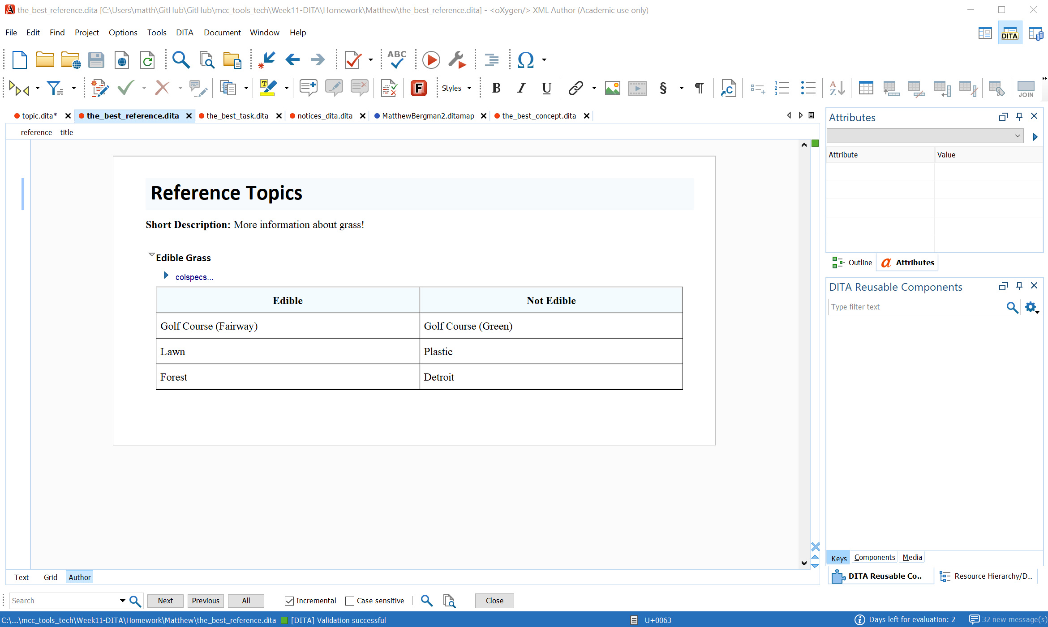
Notes:
An additional feature I like is the ability to not only create tables.

Slide 27
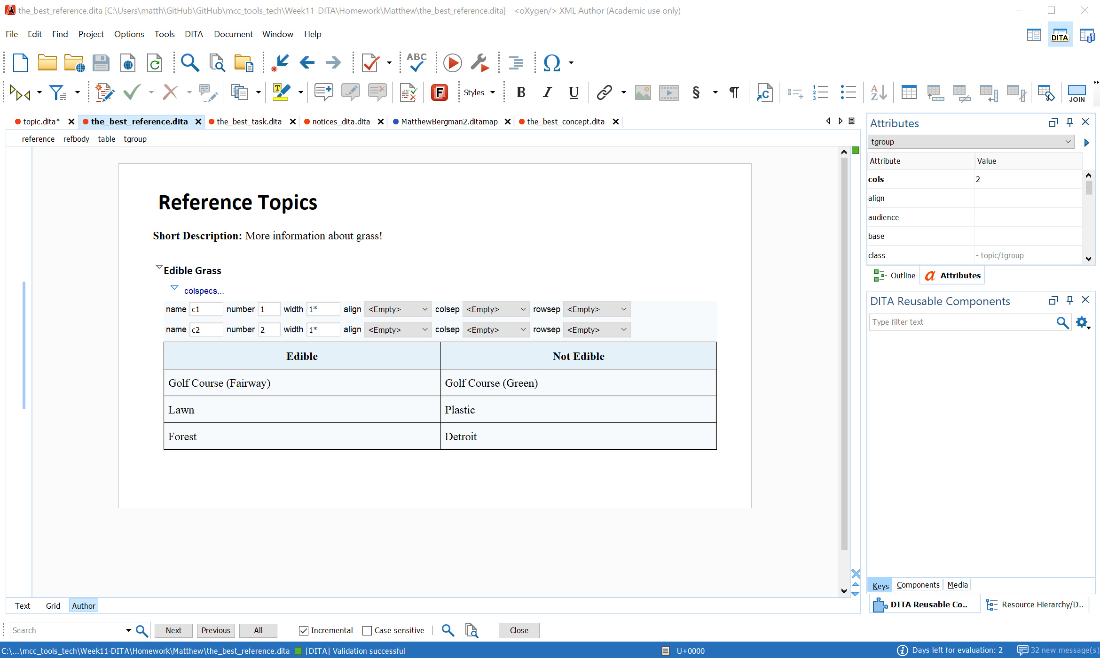
Notes:
But also edit the attributes of said table.

Slide 28
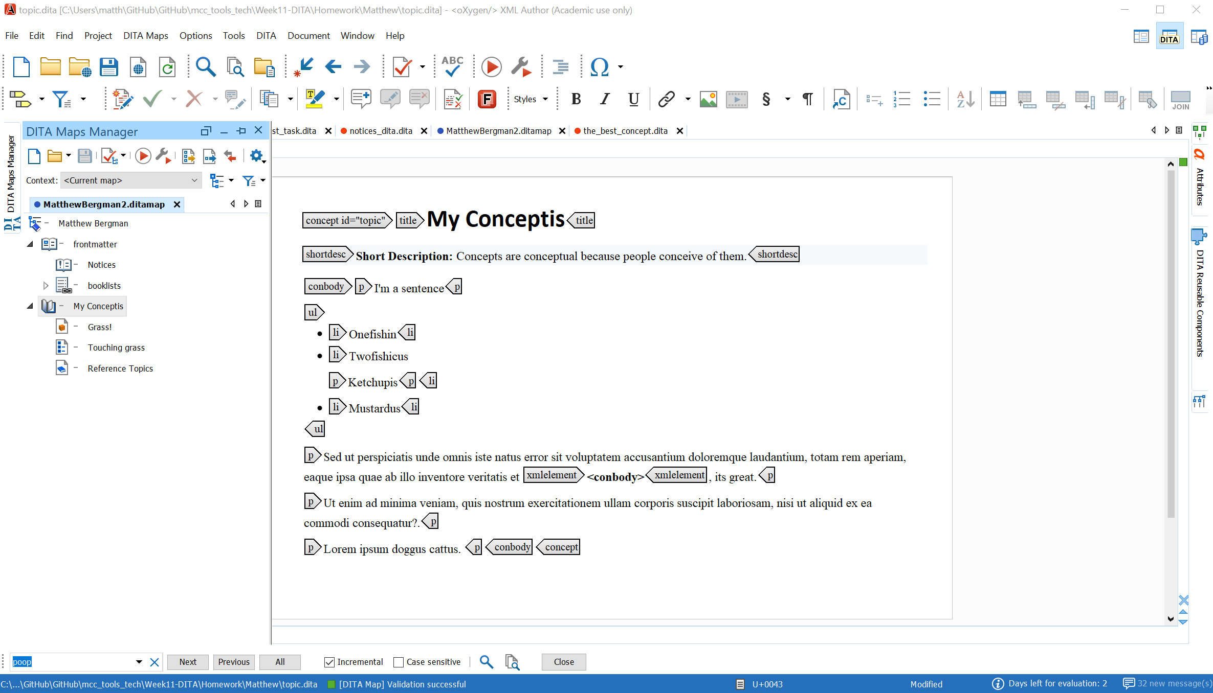
Notes:
Overall, I feel that Oxygen has the best sharing and editing interface among programs I’ve used so far. You can see your map manager, see all of your tags, convert to XML, and so much more.

Slide 29
What would I use in a team?
What makes a program usable by a team?
Easy to share and edit content
Can convert documents into other languages (for example, Word to XML)
Reliable help options
Intuitive interface, accessible to all relevant employees
Notes:
These are all very important parts of a program, especially when working in a team. The ability to share and edit content with as few hiccups as possible is, in my opinion, a must, especially in our faster paced work environments. Not everyone is as experienced with your software as you may need them to be, so having a reliable help option with real-time support can make a huge difference. Lastly, and I feel this point cannot be overstated, intuitive interfaces allow for more work to get done faster.

Slide 30
The task
Create an online help module, with a short quiz at the end
In my opinion, the best program for this task is…
Notes:
Let's imagine I’m in a team and we’re assigned to make an educational module with a short test at the end. What program would I use for this task?

Slide 31

MadCap Flare
Notes:
MadCap Flare!

Slide 32
MadCap Flare
Great for creating easily accessible help modules
Easily create online courses
Provides templates for most tasks
Can drag and drop blocks of text
Notes:
I feel this programs has some of the best features when it comes to creating online modules and interactive content. If you don’t want to make courses, it also has built in templates for brochures, pamphlets, virtually everything else you’d need for short-form content. Finally, you can drag and drop blocks of text, images, and other elements. For someone like me who feels at home with programs like Photoshop, this drag and drop feature is huge for me.

Slide 33
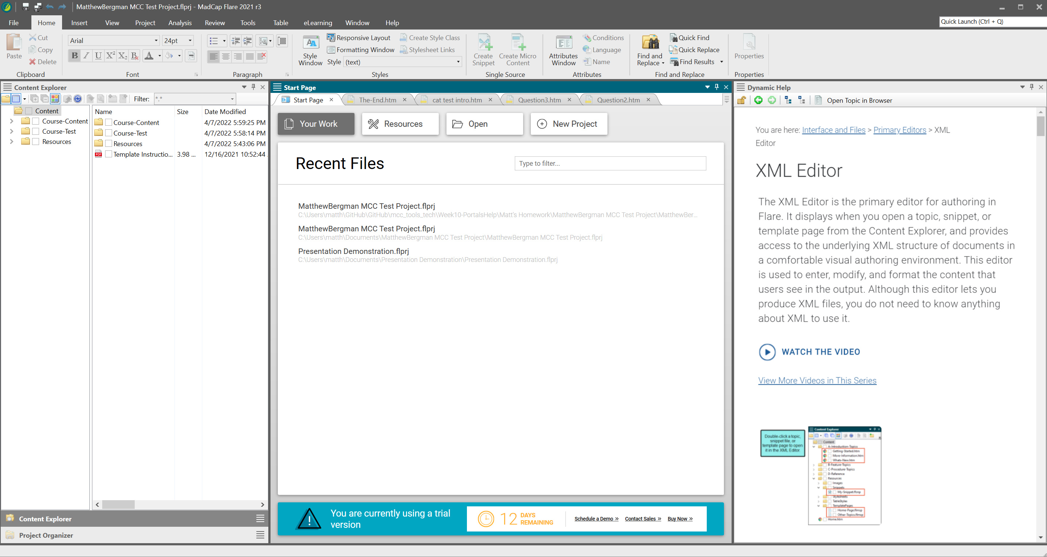
Notes:
So here’s what I see when I first start up the program. My recent files are right there in the middle. To my left are my project files, and to the right is a help section, full of introductory videos and helpful tips.

Slide 34
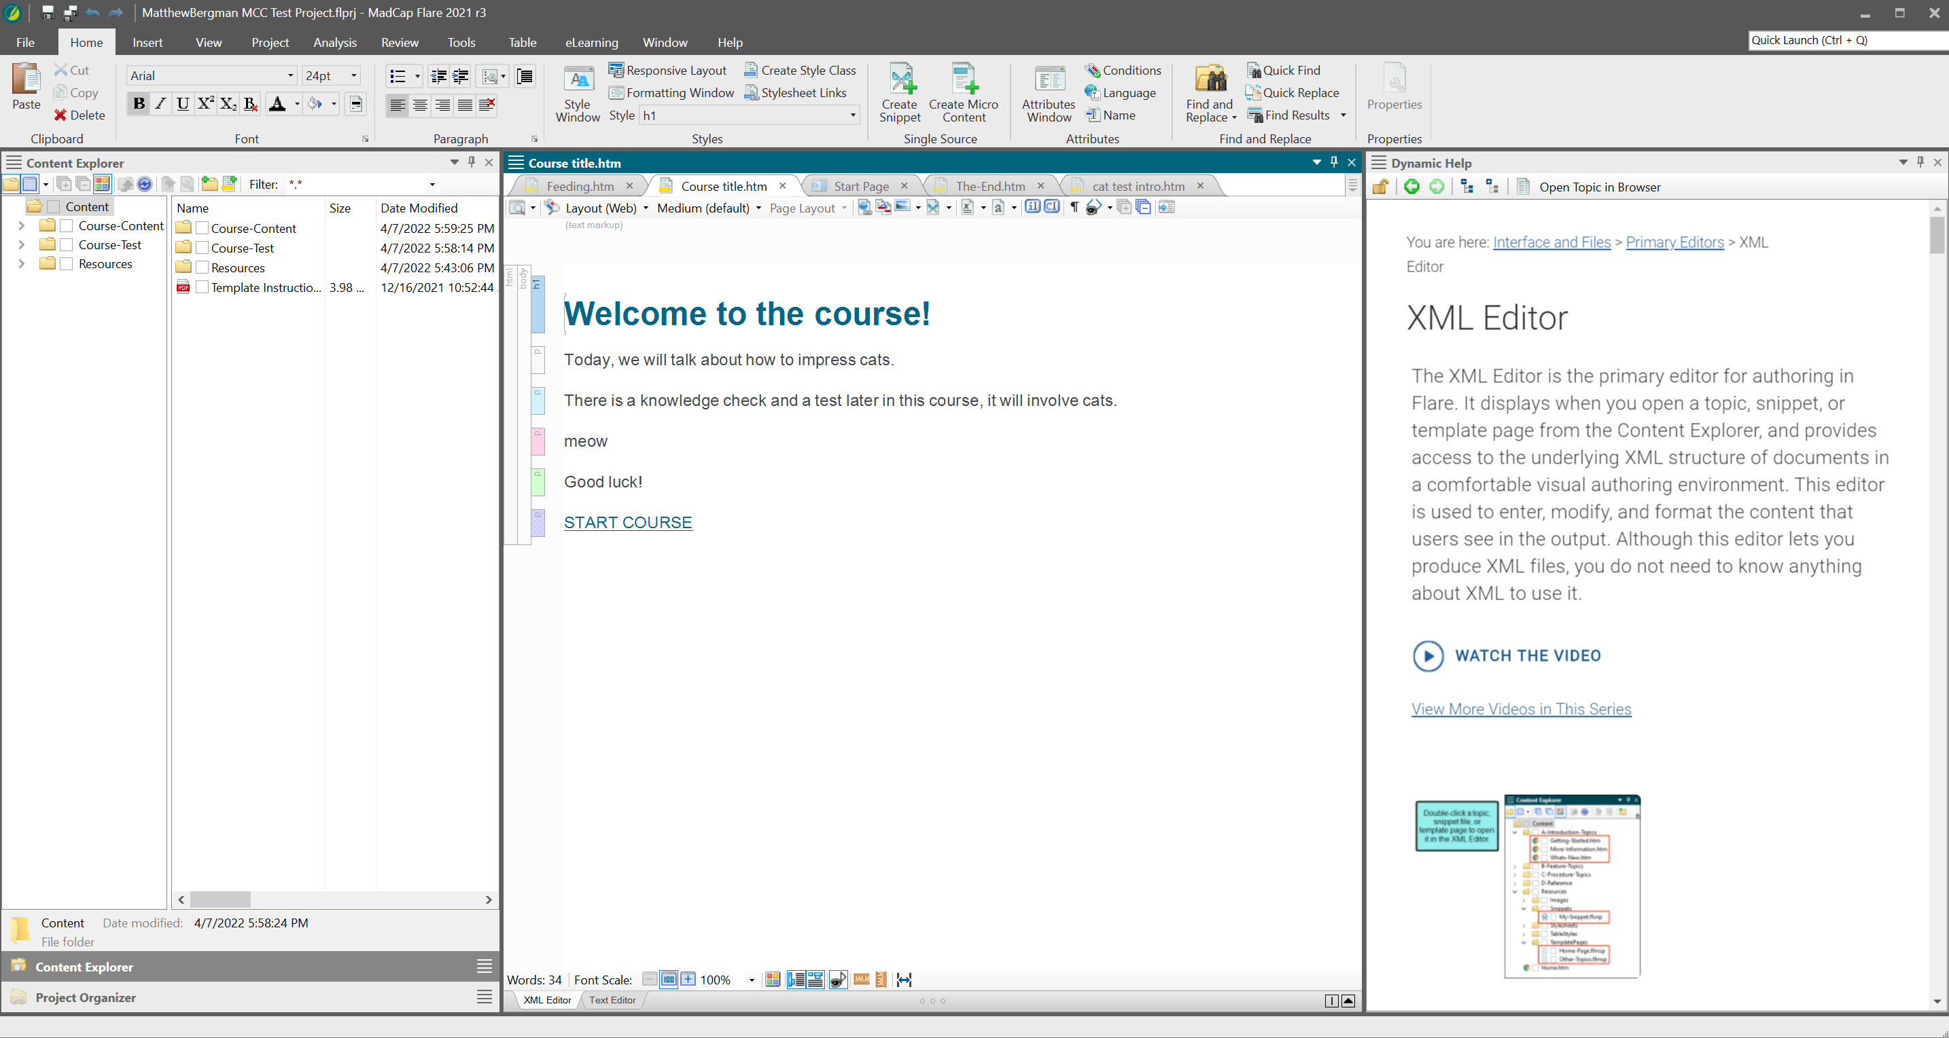
Notes:
You can list all your lines as their own <p> tags. Additionally, you can hyperlink to different parts of your project for when your end users take your course.

Slide 35
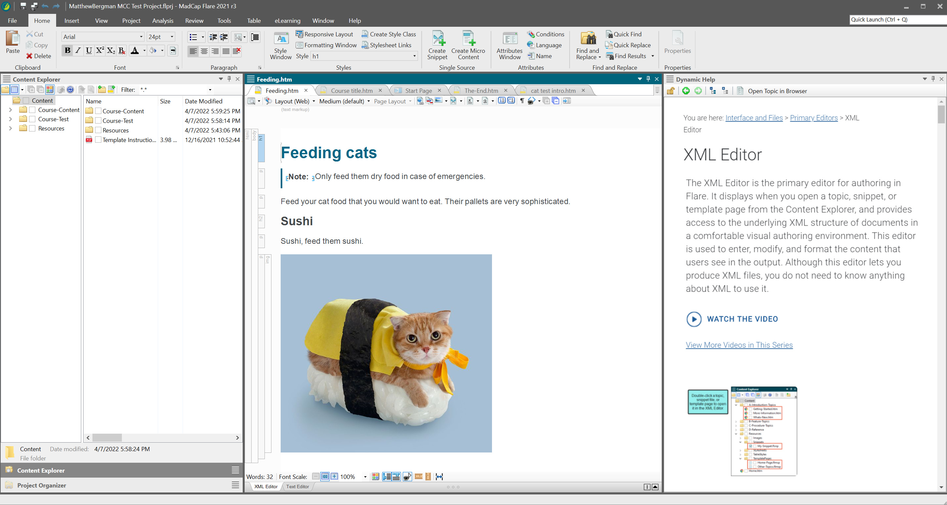
Notes:
Creating headers and inserting images is a snap. Everything should be contained in the huge body and html tags.

Slide 36
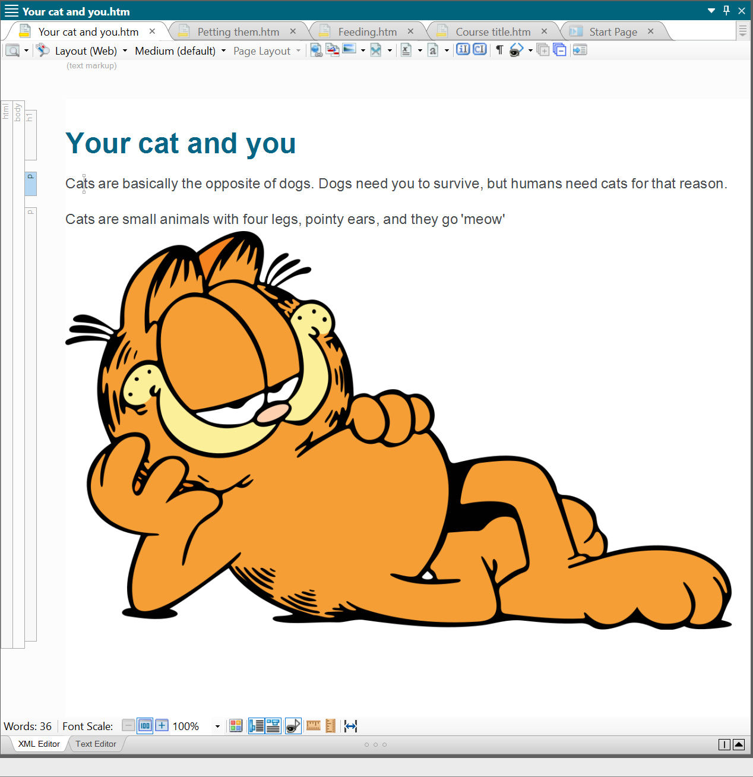
Notes:
Here, we’re going to drag and drop our image of Garfield around. Simply click and hold on the tag to select the whole element.

Slide 37
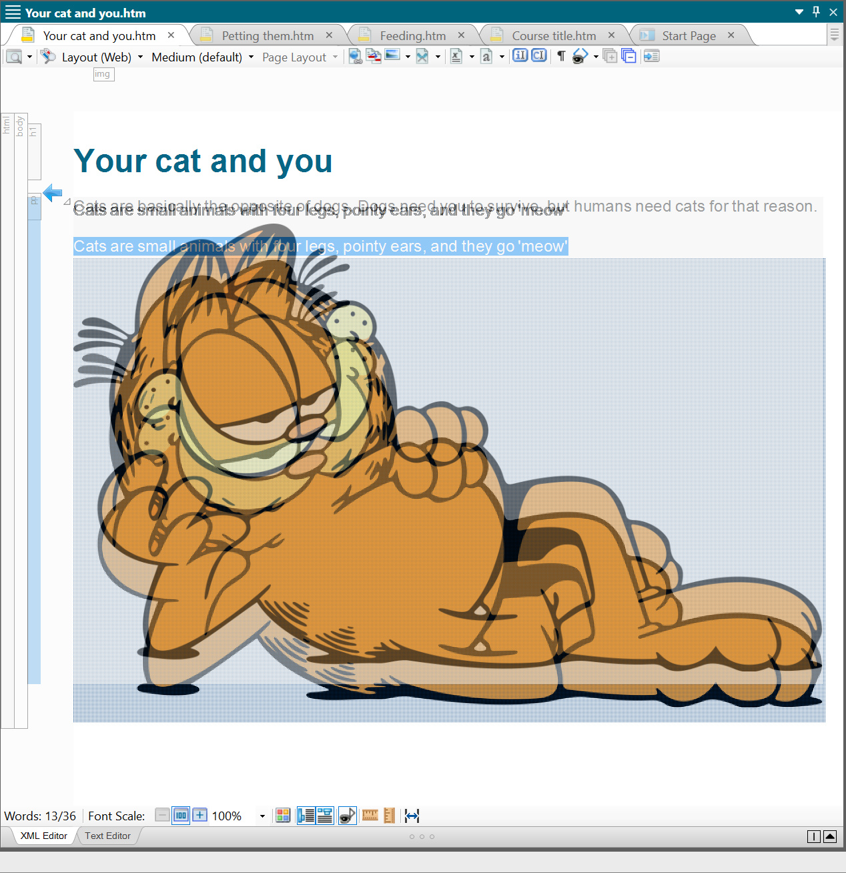
Notes:
Now you can move it around.

Slide 38
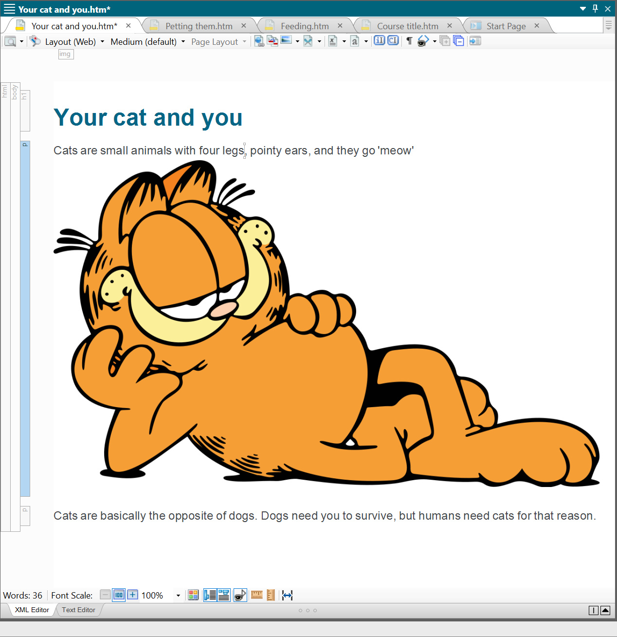
Notes:
I’ve just dragged our friend above a block of text. You may be asking “why is the picture still listed under a <p> tag? That’s a good question, lets fix that.

Slide 39
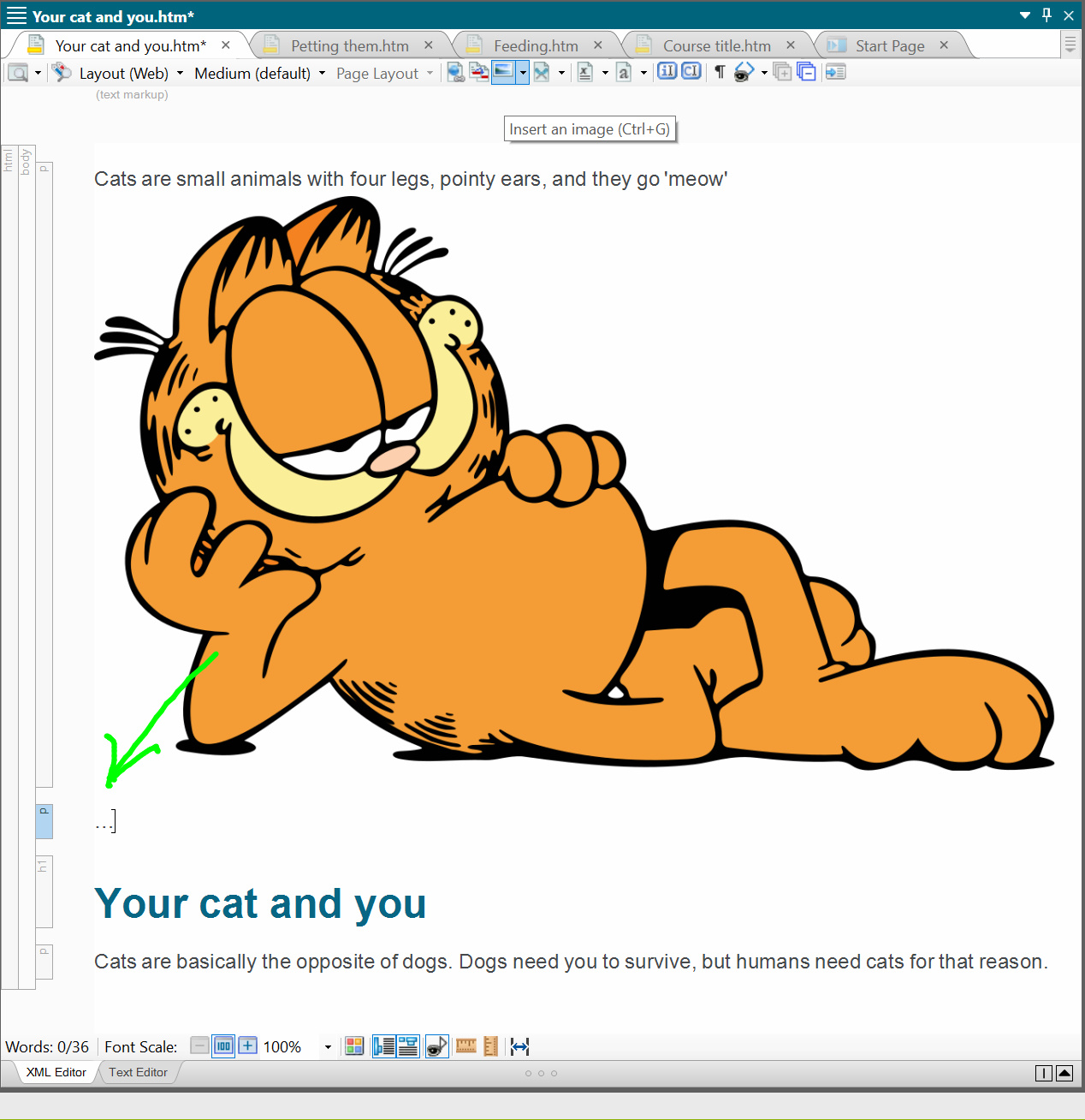
Notes:
I’ve hit enter and created a new <p> tag.

Slide 40

Notes:
With that selected, I’ll now click on the image icon above. For the purposes of this demonstration, I clicked on the black down arrow directly to the right.

Slide 41

Notes:
So I could use this handy drop down menu, instead of opening a new window and selecting the image that way.

Slide 42
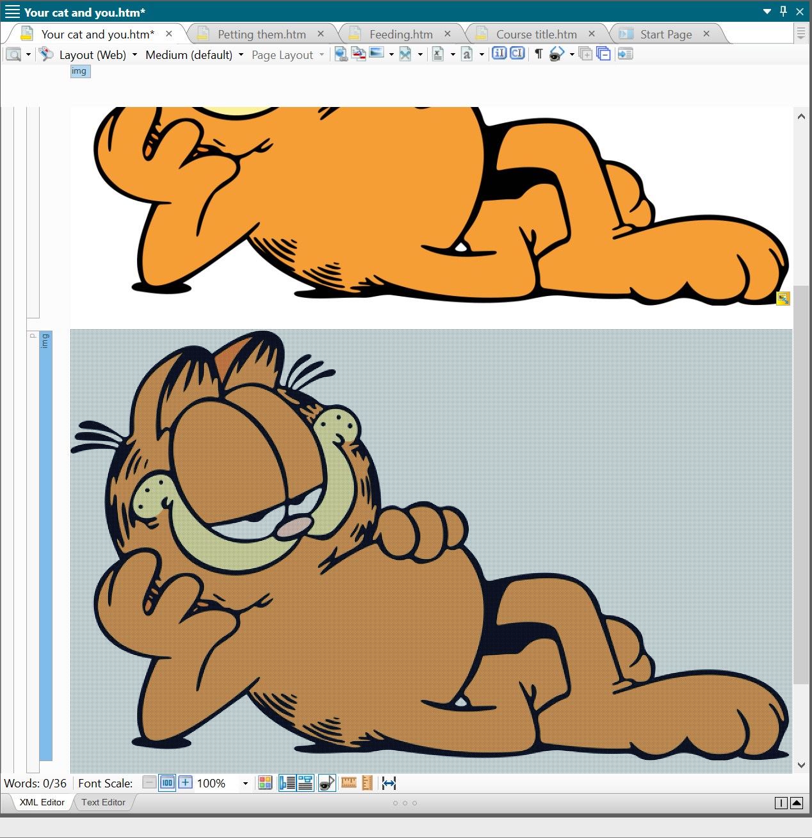
Notes:
Now we have a second image of Garfield, this time he’s in a <img> tag.

Slide 43
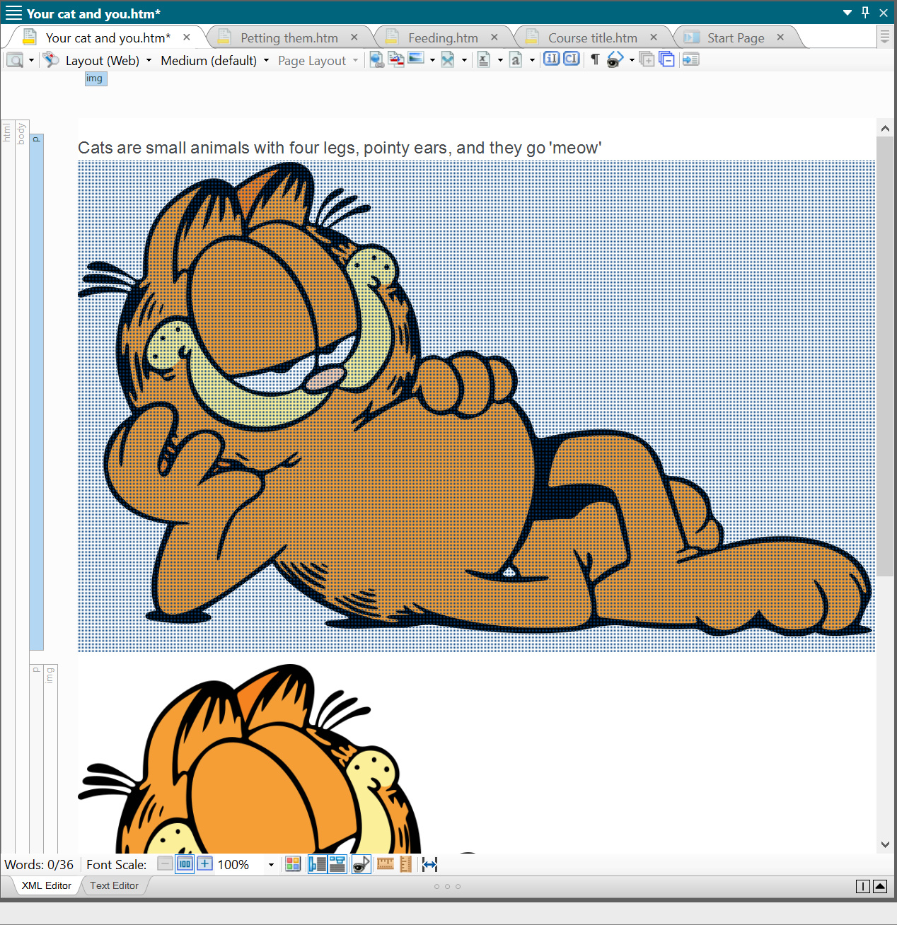
Notes:
I’ll now select our original picture.

Slide 44
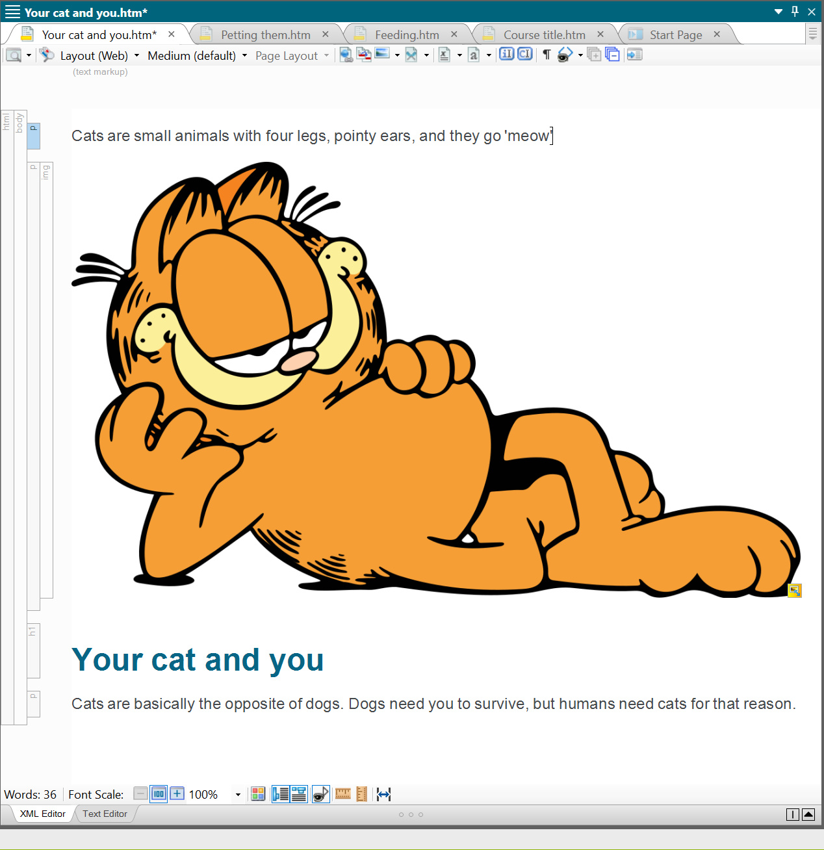
Notes:
And delete. Now the picture is in its own tag, separate from the caption above.

Slide 45
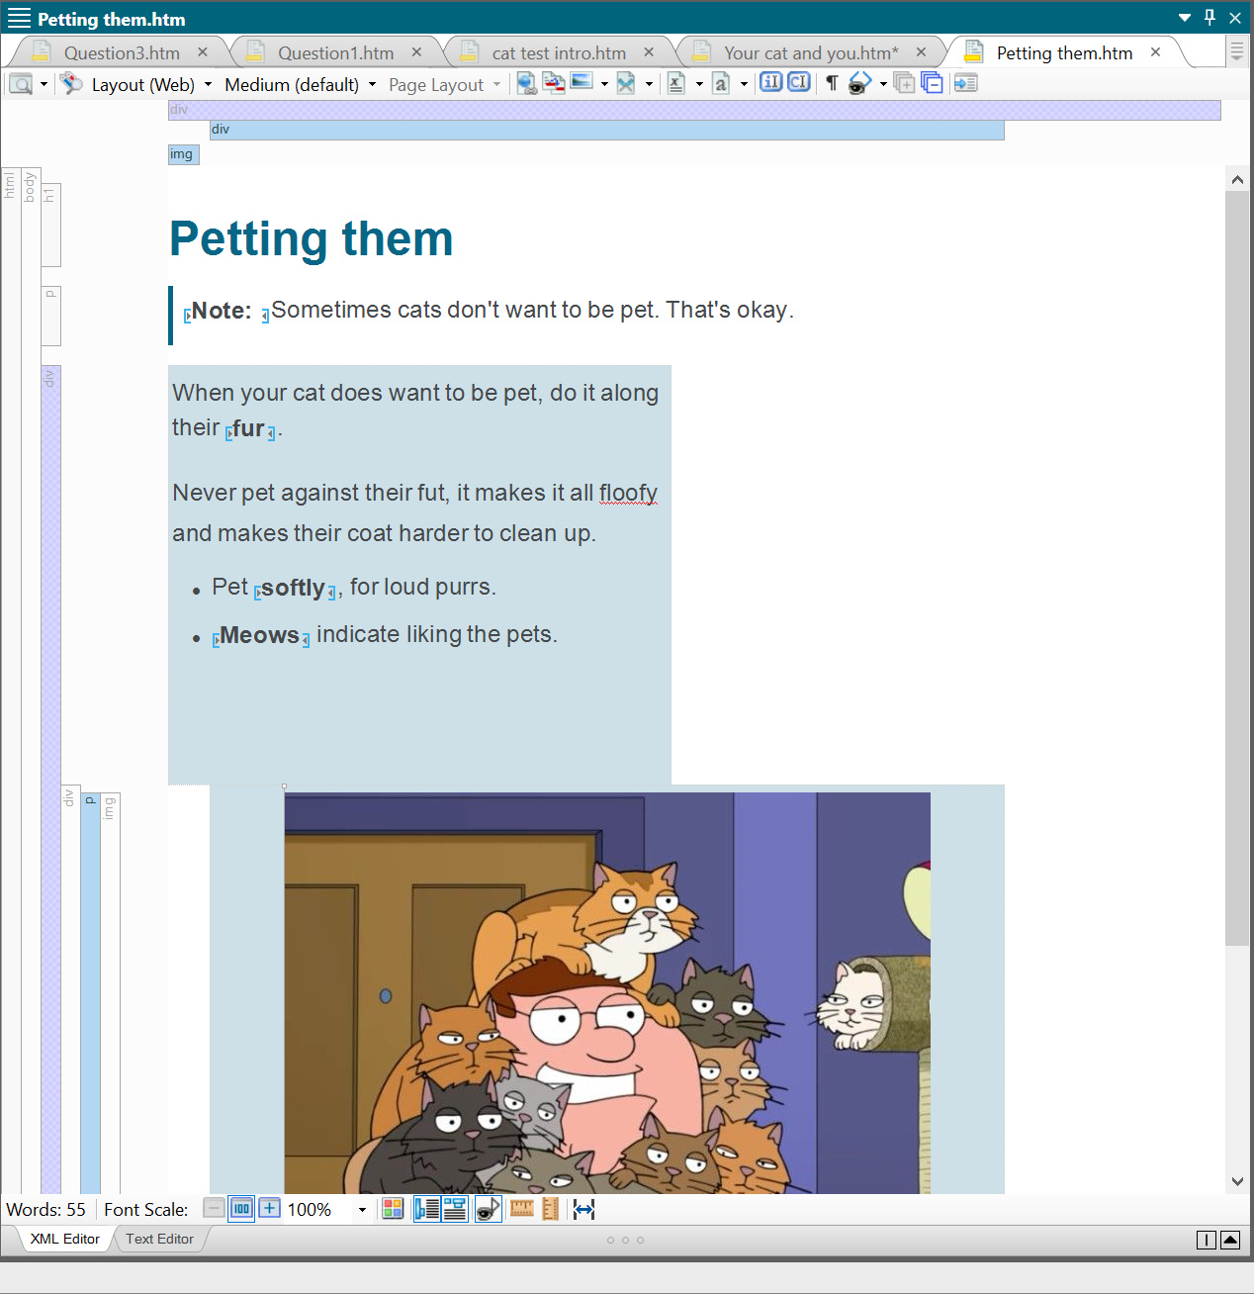
Notes:
Here’s a mostly preset page of different sections and groups. The square format, and other presets can be shared, and edited by your end users easily.

Slide 46
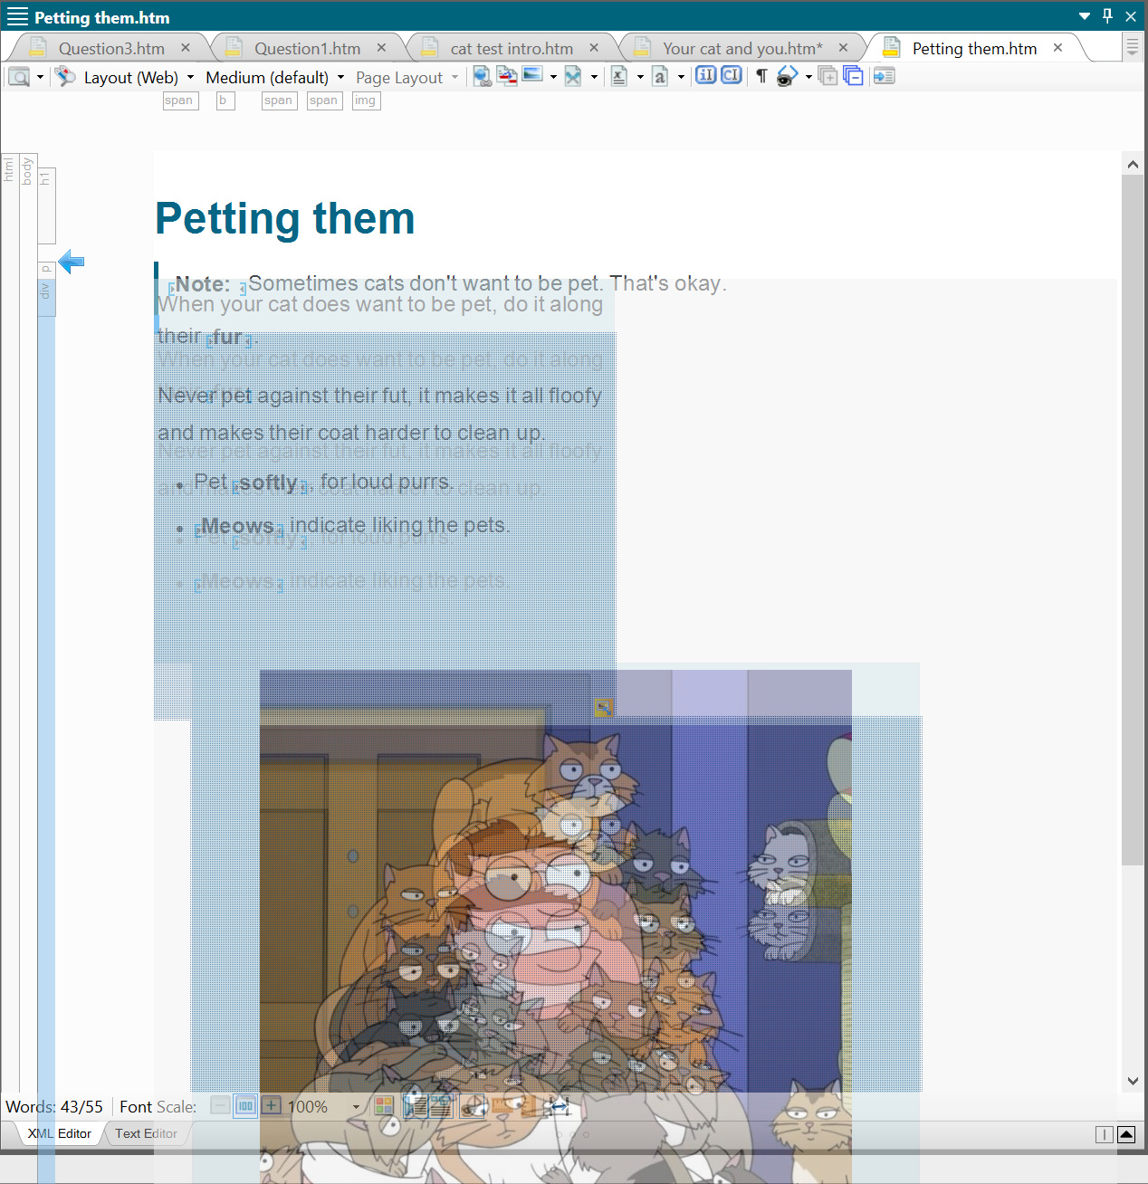
Notes:
Here, I’ve selected the entire section that contains the two squares. Putting all your elements under a single body allows for you to drag and drop entire sections, rather than just a single one.

Slide 47
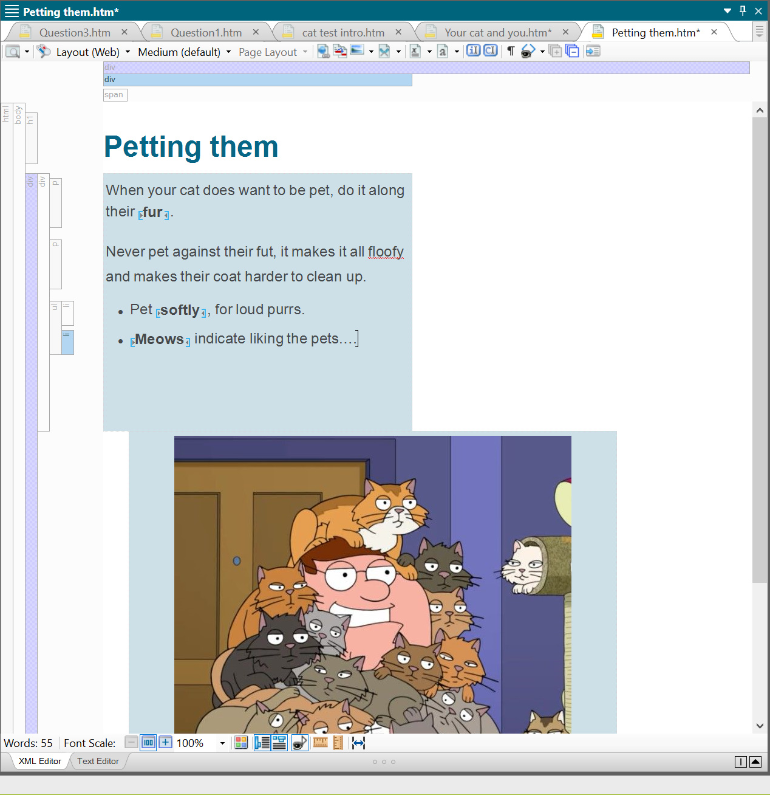
Notes:
Now all the captions are at the bottom because I’ve dragged the whole other section right below my heading.

Slide 48
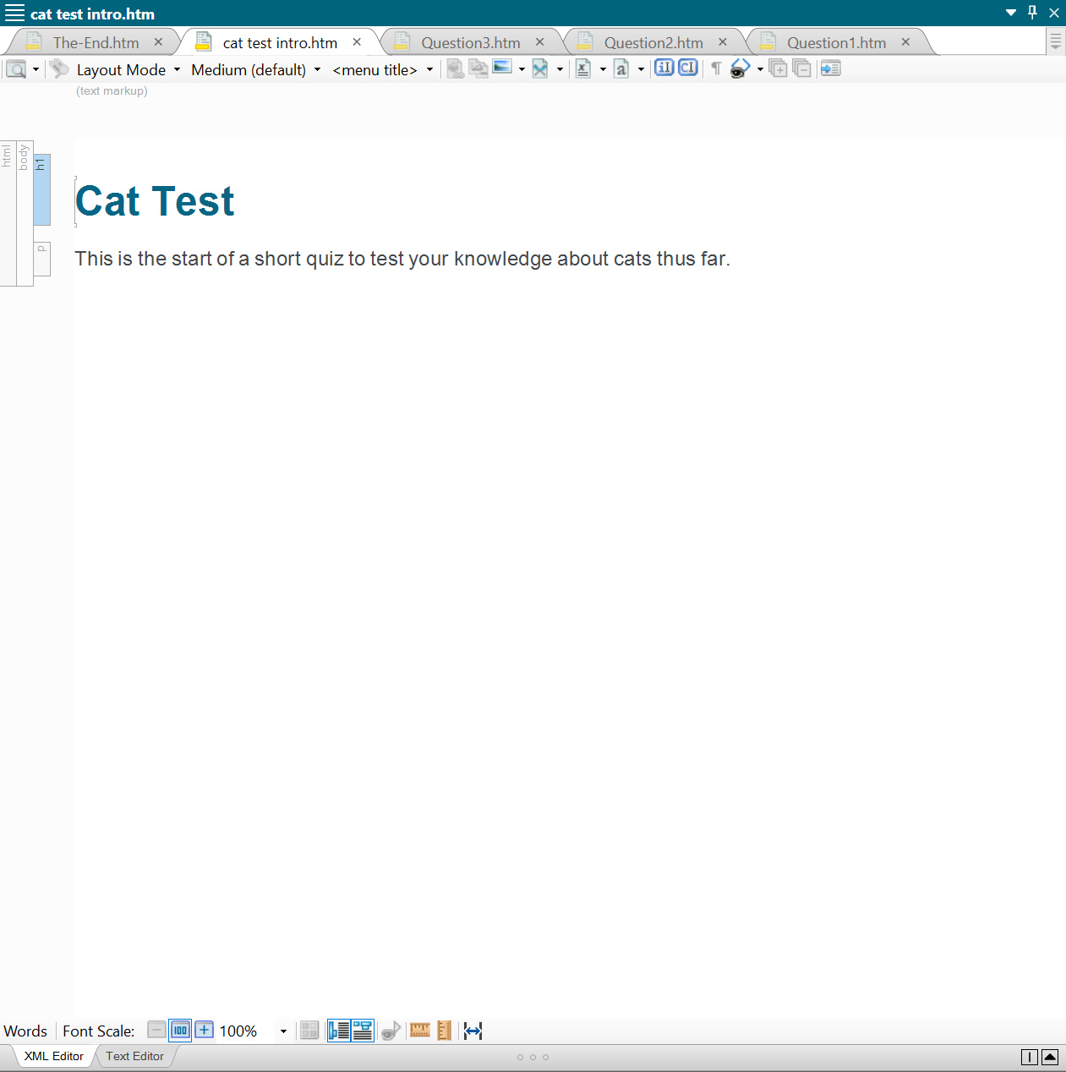
Notes:
Finally, you can create quizzes and tests, all within the same program.

Slide 49
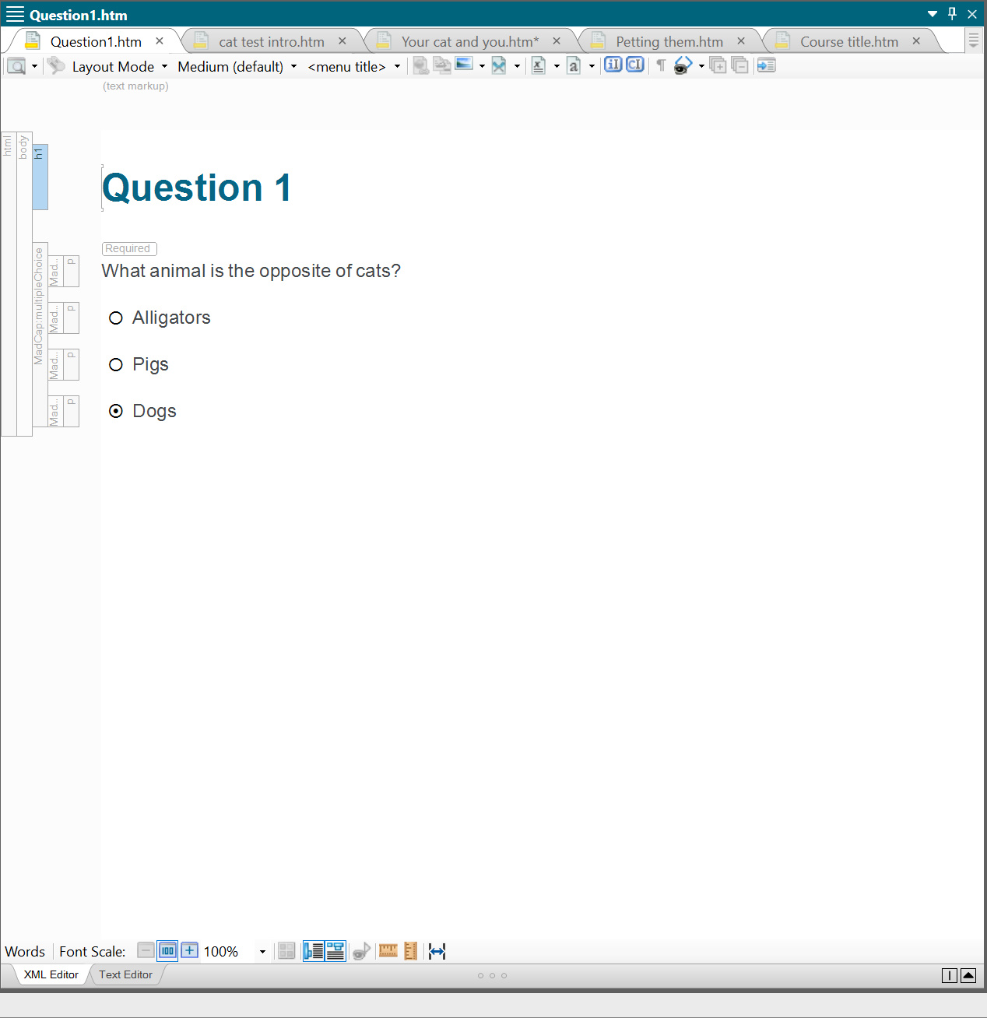
Notes:
Here I created a multiple-choice question with a set answer.

Slide 50
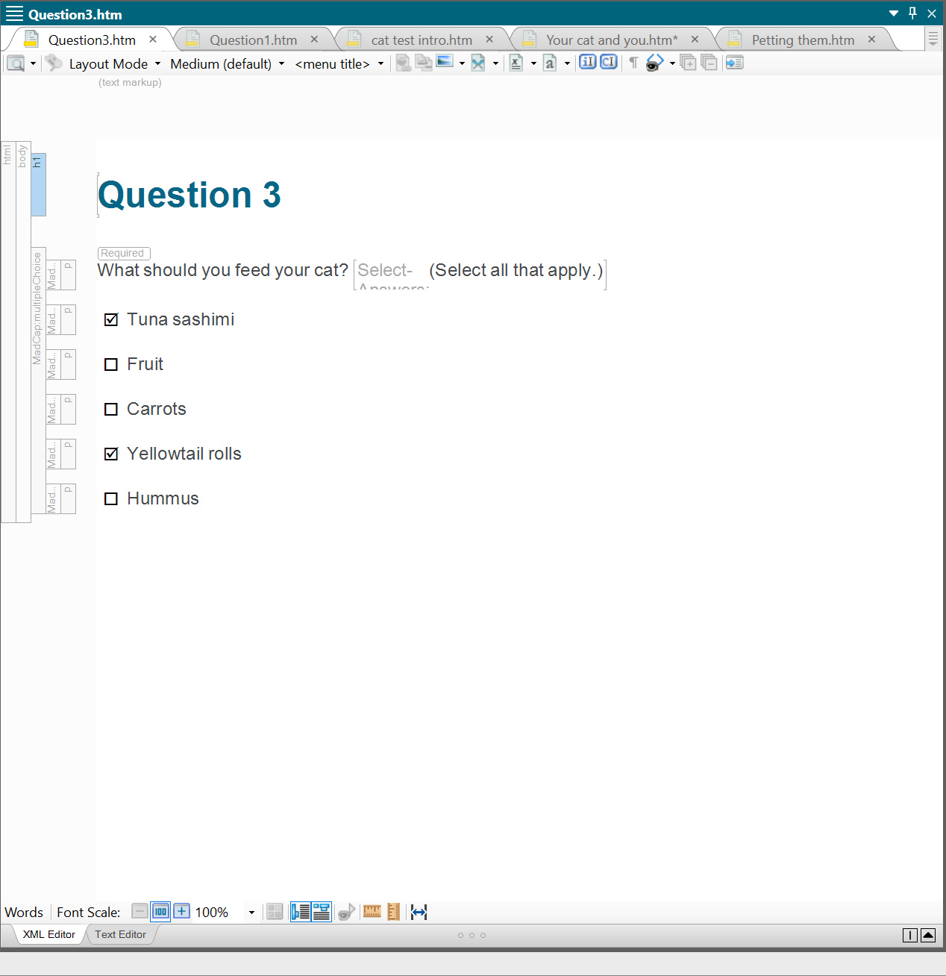
Notes:
And here is a question with multiple correct answers.

Slide 51
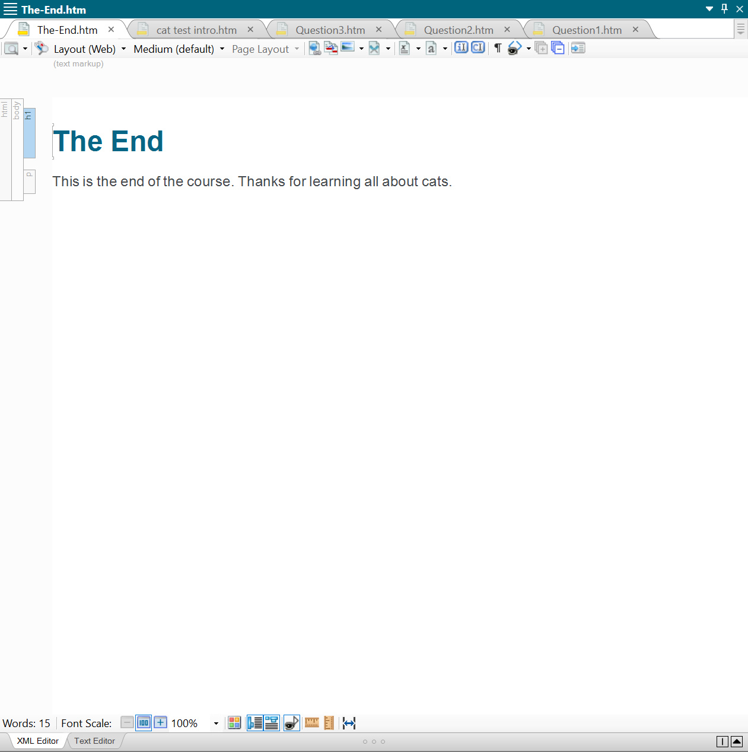
Notes:
You can also create an ending page to your quiz, thanking your end users for their time.

Slide 52
Notes:
I feel MadCap has some incredible features for specific mediums of content. You can edit pages without too much technical knowledge, using the drag and drop option. Creating tests and quizzes is also easy, and the fact I can do that and make complementary documents makes this, in my opinion, a great program for use by teams.

Slide 53
Overall
Different software for specific products
Some are more accessible than the others
Better sharing and converting is key
Templates are important
Notes:
Wrapping up, technical writing is hard. There will always be a learning curve no matter what software you use. Aesthetically pleasing interfaces could help bring new employees into the fold more quickly, but there are things teams can do to make things easier. Team leaders could make this curve less scary by sharing preset templates to their employees, which would streamline their workload to produce more consistent products. Additionally, using the right software for the right task should always be a consideration; you could use Oxygen to make a quiz, but MadCap, from my experience, makes it easier. In our current environment, where the faster companies can turn out products, the more successful they are, accessibility and ease of use are paramount. The challenge most programs have, in my opinion, is flattening peoples’ learning curves as much as possible, while remaining robust enough to be used professionally and consistently.

Slide 54
The End
Presentation by Matthew Bergman
Notes:
That is the end of my presentation! I hope you all enjoyed.

